Slide 1
fruit
Lee

Slide 2
Introduction
Different people consume different kinds of fruits due to various reasons. Various reasons includes tastes, health effects, weight loss and skin whitening. Some fruits are more liked than others while some people dislike all fruits. Different genders also like different fruits and spend different amounts on purchasing fruits. The purpose of the bar graph is to analyse the number of people who like the different types of fruits including pineaples, apples , bananas and oranges. The graph will also analyse the reasons why different people eat different fruits.

Slide 3
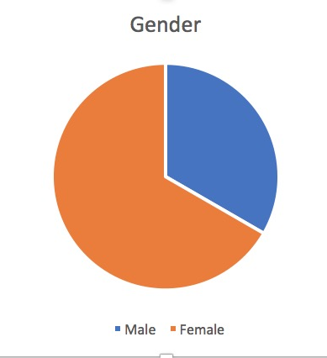
The analysis will be based on two genders which are male and female. The total number of people analysed is 30 where 20 are females and 10 are males.

Slide 4
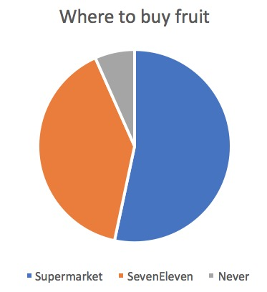
Place of buying
Different people buy the fruits from different places. 16 people buy the fruits from the supermarkets. 12 people buy the fruits from seven Eleven and 2 people do not buy fruits from neither of the two places.

Slide 5
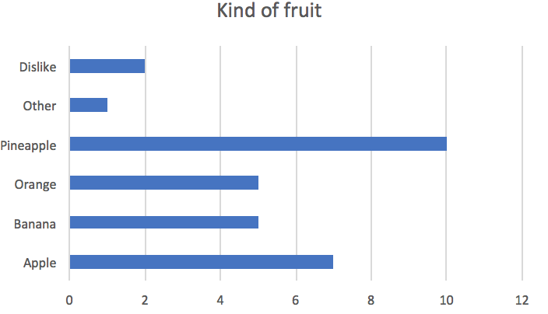
Kind of fruit
The graph analysis four main types of fruits including pineapples, apples, oranges and bananas. All other fruits are classified as others. 10 people like pineaples. 7 people like apples. 5 people like oranges and bananas. Only one person like like other fruits while two people do not like fruits.

Slide 6
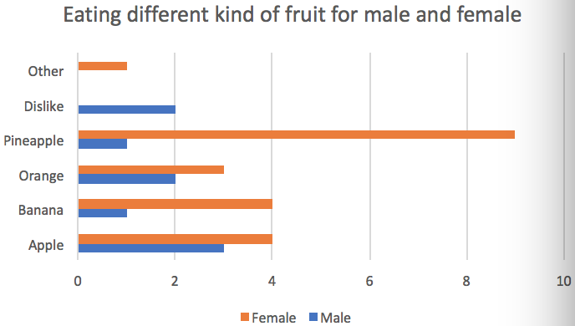
Different eating behaviour by different genders
One female lie other fruits. Two males don’t like fruits. 9 females and 1 male like pineapple fruit. 3 females and 2 males like orange fruits. 4 females and 1 male like bananas. 4 females and 3 males like apple fruit.

Slide 7
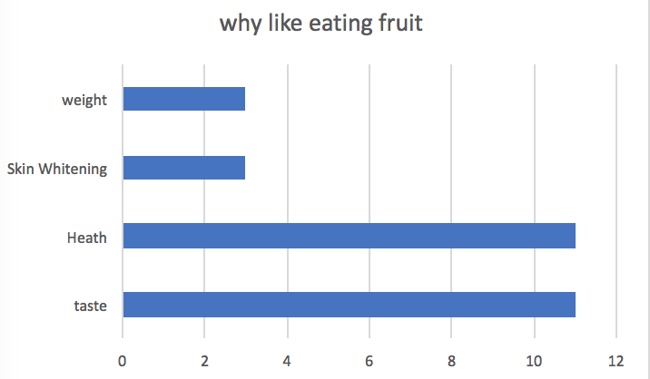
Why people like eating fruits
3 eat fruits to lose weight or whiten their skins. 11 eat fruits fro health purposes and taste.

Slide 8
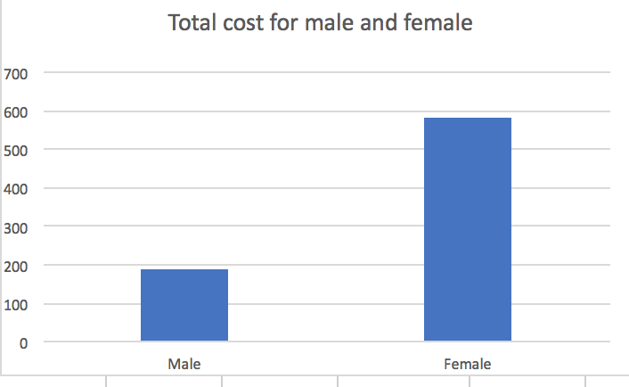
Total cost for male and female
The total cost incurred by males in purchasing fruits is 190 while the total cost incurred by females in purchasing the fruits is 584.

Slide 9
conclusion
According to the analysis, the general findings are that pineapple is the most liked fruits and is highly consumed by females. Females in general spend more on fruits than males. Many people buy their fruits from the supermarkets. The two main reasons why people eat fruits are tastes and the health effects.

