Slide 1
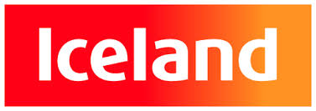
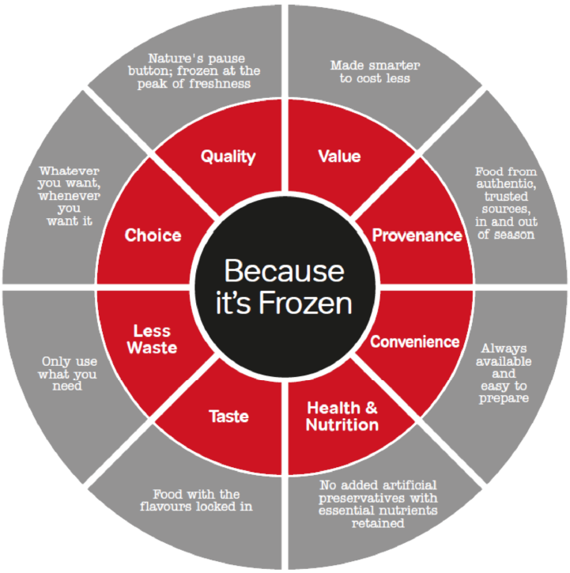


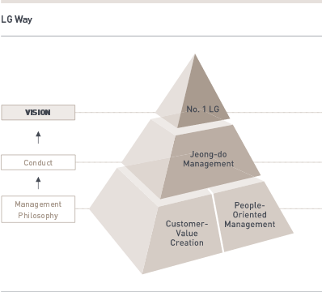
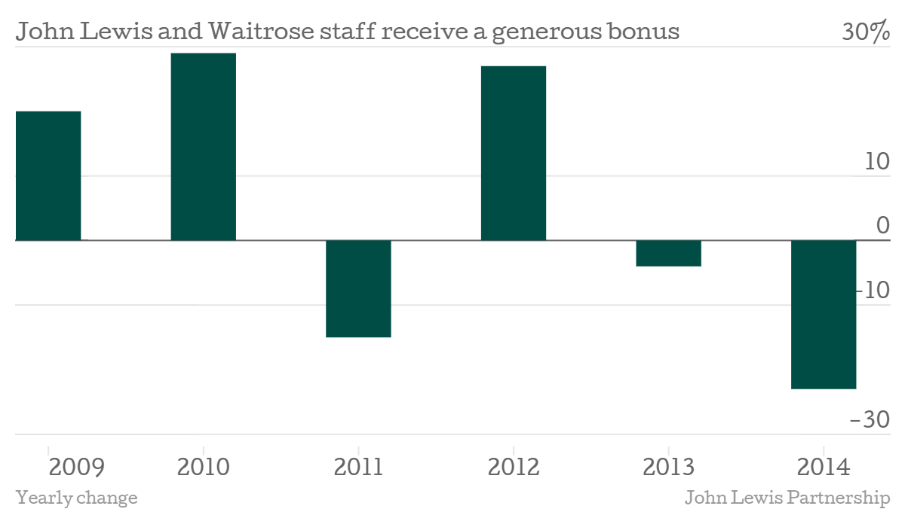
Iceland Ltd
Details about the Company
Contacts: Deeside, Wales, United Kingdom.
Tel: 0800 328 0800
Demographic: over 23,000 employees.
Income: £160 million.
Net Profit: £150 million.
Brief Background
Founded by Malcolm Walker in 1970 in England and by 1978, Iceland had 28 stores under the same brand. The company has grown to over 800 stores across the UK in the retail industry specializing in frozen foods.
Analysis of the Company
• Individual Level
Iceland employs all kinds of people including managers, technicians, and retailers, skilled and unskilled workers. Their main focus is harnessing increased talent through flexible application mechanisms.
These employees fit into the organization in the post-hiring stage. The company was awarded the Best Company to Work Award in 2012 and 2014 based on their ability to offer employees a Fair Deal. Iceland has an effective well-being support for its employees illustrating increased happiness and job satisfaction.
• Team/departmental level
Iceland has a national organizational structure basic to common companies. The senior management from its CEO and founder Malcolm Walker are the top decision makers while other duties are delegated downwards.
Iceland is designed as a descriptive structure where each store is assigned a manager who heads a single store. This type of design ensures that managers are held accountable for their actions and the performance of each store.
Iceland does not support team work effectively sine most decisions are carried out by managers. Most of the managers make decisions that are effective and efficient for their staff. However, individual teams especially in the retail departments are not much encouraged.
Departments, roles, and functions communicate through meetings mostly developed by managers. Moreover, they also utilize internal communication systems that allow reporting, monitoring, and changes in operations.
• Organizational Level
Iceland is based on a culture of fun, well-being, and happiness for employees. They believe that a happy employee equal to increased productivity, performance, and excellent customer service. In turn, this keeps customers happy and willing to buy from the store. The leadership style is transformational leadership. This is based on the continued guidance of Iceland under its founder and current CEO, Malcolm Walker. Walker developed a vision for the company and continues to pursue the vision to its current success.
The effectiveness of the company is mostly financial and in terms of human resources. Iceland has held strong financial performances over the past few years with sustainable cash flows, sales, and profit. Moreover, the company has been recognized for its employee pay and benefits that includes well-being such as Fair Deals and even paid holidays and vacations for managers. The firm’s current net income is about £166 million with a net profit of £155 million.
Concluding Statement
Iceland is a success story under the leadership of a visionary leader. It welcomes great talent in all areas of its operations. Teamwork is not effectively implemented, but employee benefits, pay, and well-being are of great quality. The culture encourages employee happiness and fun in the company.
References
Iceland, 2015. The Iceland Story. Retrieved from http://about.iceland.co.uk/about-iceland/the-iceland-story/
LG Electronics
Details of the Company
Contact: lG twin towers, 128 Yeoui-daero, Yeongdeungpo-gu, Seoul, Korea.
Tel: 82-2-3777-3263.
Demographic: 82,000 employees
Net Income: 56 trillion Korean won
Net Profit: 11.2 trillion Korean won
Brief Background
LG was founded under the name GoldStar by the Korean government in 1958 to develop electronics for the Korean market after the war. It began exporting electronics to the U.S in the 1980s and later adopted the brand LG in 1994. Currently LG is a global leader in manufacture of electronics including TVs, Fridges, and mobile devices among others.
Analysis of the Company
  Individual level
LG Electronics is an international brand with a wide variety of job offering. Therefore, it employs international talent across different areas of its industry to work in different regions of the world including all continents of the world.
The employees fit into the company through the pre-hiring and post-hiring stages. LG has a talent management system that includes industry –academia systems and scholarship programs especially for science and technology graduates. LG also has comprehensive training and talent management systems in the post-hiring stages that help build up its core competencies enabling it to remain a world leader in its industry.
  Team/departmental level
LG has a global organizational structure that offers its overseas companies the leadership and operational autonomy. This type of structure is designed to ensure speedy decision making processes and respond to regional changes without wasting time and crucial resources.
LG is designed as a contemporary organization that has delegated different roles to heads of administration especially in its overseas businesses. Moreover, the company is headed by a CEO who guides different top executives under the traditional business departments.
LG supports increased team work as the company is diversified in its industry. Moreover, LG has remained on top of its game through innovation. Innovation has been successful through increased team work. Employees are encouraged to work in teams to solve problems and innovate on existing technologies.
Communication of roles, departments, and functions is conducted primarily in training. Furthermore, the company uses meetings and emails to communicate relevant issues in terms of team work.
  Organizational level
LG’s organizational culture is pursuing to become the number 1 through people-oriented management and customer value creation. The company utilizes a transaction type of leadership where there is increased resistance to change especially in LG’s company structure. Moreover, the company also rewards its employees highly illustrating increased motivation.
The company has performed tremendously based on the reduced employee turnover and increased profits. The company recorded a decrease in all its financial in 2015 in net income, profits, and equity.
Concluding Statement
LG is a successful and multinational electronic company. It has highly developed employment systems and a wide global talent management system. It has the ability to foster teams to tap into the innovation pool. Its corporate culture and leadership style are less contemporary while its performance is still below average.
References
LG, 2015. Talent Management. Retrieved from http://www.lg.com/global/sustainability/employee/talent-management
LG, 2013. Sustainability Report 2012-2013. Retrieved from http://www.lg.com/global/pdf/Sustainability-Report/2012-2013%20Sustainability-Report.pdf
John Lewis Partnership
Details About the Company:
Contacts: 171 Victoria Street, London SW1E 5NN.
Mail: John Lewis Partnership, Carlisle Place, London SW1P 1BX.
Demographics: 88,900 employees.
Revenue: 11 billion pounds.
Net Income: 409 million pounds.
Background:
Founded by John Spedan Lewis back in 1864 and later acquired Waitrose in 1937. Lewis set up the business as a partnership with a governance system including a constitution.
Analysis of the Company
  Individual Level
The company employs all kinds of people as all employees are regarded as owners of the company. This includes senior management, managers, supervisors, and personnel. Most of the employees are females at 53% while males are at 43% with White ethnic groups being most employed at nearly 94%.
At Lewis, the employees fit in the organization in the post-recruitment stage. Their main aim is in recruiting and developing talent especially across the Black, Asia, and Minority Ethnic employees.
  Team/departmental Level
Lewis utilizes a National organizational structure that is headed by the Lewis Partnership Trust Ltd. The organizational structure is governed by a written Constitution that ensures all decisions made are supported by partners or the employees.
The company is headed by the Partnership Council, Partnership Board, and the Chairman or managing director. The Partnership Board approves numerous committees on the company’s operations such as CSR, Remuneration, and Risk management. These top bodies and chairman are then delegated to the Partners Council or the employee council HR, CFO, and the Managing directors of its businesses.
Lewis Partnership has an effective way of treating their teams through recognition. The company praises its teamwork efforts especially in different departments. Management encourages team work through internal promotions and recruitment as well as increased autonomy to pursue innovations and proposals.
Departments/roles/functions communicate effectively through the Partnership council, committees, and forums. Employees across different teams are able to collaborate on new ideas and proposals.
  Organizational Level
Lewis Partnership organizational culture is based on creating and developing better careers, better performing employees, and better pay. This is enshrined in their 4Ps including performance, progression, pay, and productivity. The type of leadership illustrated is servant leadership where managers and top management act as servants and stewards ready to listen and act on individual employee needs.
One of the key measures of the company’s success is employee happiness through job satisfaction. The company reported that 77% of employees are satisfied at the company. The company has not been performing optimally in terms of profits. However, the company has gained increased market share with high sales volumes as well as increased number of customers. The company expects to increase profits in the near future from this. Gross Sales reached £10.9 billion with a profit of £442.3 million a 7.5% decrease from the previous year.
Concluding Statement
John Lewis Partnership is an exceptional company where employees own the company in profits and values. It is diverse in its employment and highly supports team work based on the partnership values. Employees are required to be committed to progress and development as well as the shared values of the company. Its performance is on average and may be able to sustain its future growth.
References
John Lewis Partnership, (2016). Working for Us. Retrieved from https://www.johnlewispartnership.co.uk/csr/our-partners/the-4ps.html
John Lewis Partnership, (2015). Annual Report 2015. Retrieved from https://www.johnlewispartnership.co.uk/content/dam/cws/pdfs/financials/annual-reports/john-lewis-partnership-plc-annual-report-2015.pdf

