Slide 1
MEXICO PORTFOLIO
Student’s Name:
Professors Name:
Course:
Date:

Slide 2
Basic History
Some areas in Mexico was initially occupied by Indians who had various social and economic systems.
Other areas in Mexico were occupied by agriculturalists such as Yucatan, Maya, Huastec, Aztecs and Tarascans.
The Mayans developed the calendar and writing systems and built cities for the surrounding farms.
The Toltecs conquered central and southern Mexico by AD 1100 where they built Teotihuacan city.

Slide 3
Basic History
The Aztecs were conquered in 1521 by Cortez and his followers. He then colonized the area and named it New Mexico.
Many people converted to Catholicism following the arrival of missionaries in 1523.
Mexico gained independence from the Spaniards in early 1800’s(Russell 111)

Slide 4
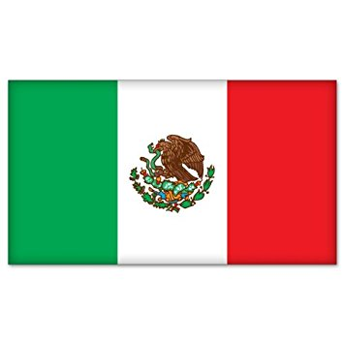
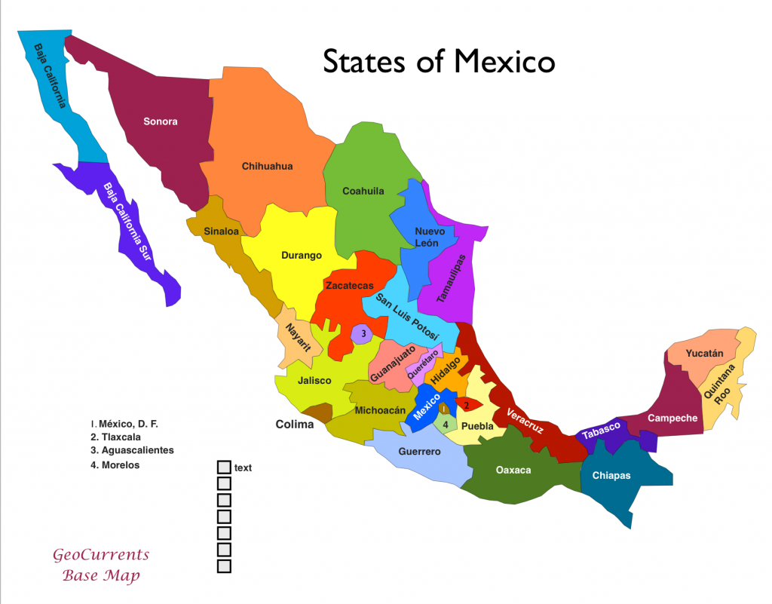
Demographics
The green color symbolizes independence, white is the Roman Catholic religion and Red is for union.
Mexico is approximately 1.964 million km² with a population of 127.5 million people.

Slide 5
Type of Government
Mexico is a federal democratic republic where the president is the head of the government and state.
The government has three branches that include the legislature, judiciary and executive.
The practices in these three branches can be traced back to the colonial period.
The constitution relegates powers to the 31 states in Mexico

Slide 6
Current Leader
Enrique Peña Nieto is Mexico’s current president.
Born on 20th July 1966.
He is a lawyer
Joined the Institutional Revolutionary party at 18 years old.
Gained political prominence when he became a governor in 2005-2011.
He has also served as a secretary of administration in the state of Mexico from 2000-2002.

Slide 7
Current Status of Women in Mexico
Women in Mexico have the right to vote.
They were granted this right in 1953 by Adolfo Cortines who issued a decree to reform the constitution.
Mexico also has policies that encourage active participation of women in politics.
Women in Mexico account for 35% of senatorial seats and 38% of the legislators in the lower house.
The gender gap in education has decreased over the last 50 years hence more women have access to education.

Slide 8
Patricia Espinosa
Born in 1958
She is a politician who has served as an ambassador to countries such as Germany and Austria.
She has also served as the secretary of foreign affairs where she prioritized immigration, diversification and security issues.
She is currently the executive secretary of the framework convention of the US.

Slide 9
Mexico’s Closest Allies
Mexico is allied with the United States because of their trade relations.
Mexico also provides documented and undocumented labor to the US(Smith117).
However, when it comes to comparing Mexico to other countries,it has some similarities with Spain.
The two countries speak Spanish and the Mexican cuisine has some Spanish aspects

Slide 10
Conclusion
Mexico’s Unique culture, numerous tourist attraction, their unique cuisine are some of the things that would make me want to visit Mexico.
Another aspect that would make me want to visit Mexico is the friendly nature of the Mexican people.

Slide 11
Work Cited
Russell, P. The History of Mexico: From Pre-Conquest to Present. Nueva York ; Londres : Routledge, 2010.
Smith, C. Inevitable Partnership: Understanding Mexico-U.S. Relations. Boulder, CO : Lynne Rienner Publishers, 2000.

