Slide 1
Wireless Charge Service
18211534 Chow Cheuk San
18219322 Lam Chi Ho
18220061 Hung Chi Kwong
18217265 Ng Chun Ho
18219691 Hung Ka Ki

Slide 2
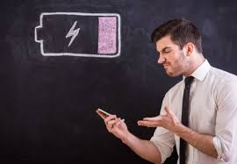
Ask you a Question !
Do you ever face the problem that your phones running out of power?

Slide 3
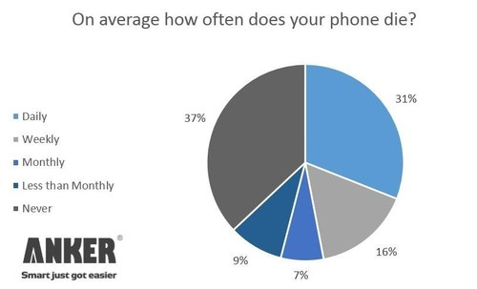
Survey
Anker(2014):
47% phone dies
At least weekly
Notes:
31% phones dead daily

Slide 4
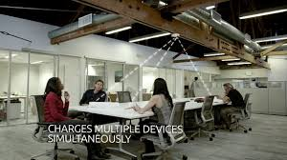
What is our team?
Our Team - Wireless Charging Services
Sign Contract to big company - Earn profit
To solve the battery or charging problems
Notes:
Our team is to start up a business to provide wireless charging services
Sign contract - to big company e.g. cafe, university, big company
To solve the problem of not enough battery or improve charging services

Slide 5


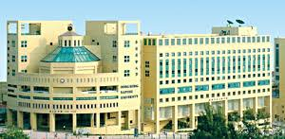
First Target:
Starbucks
University e.g. Baptist University Campus

Slide 6
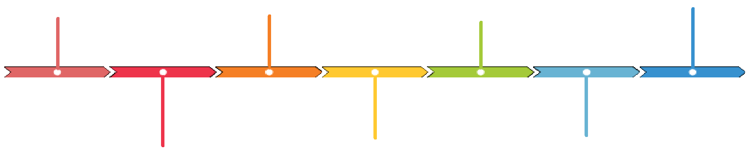
Content
Services Development
Marketing Strategy
Introduction
Q & A
Operational Plan
Financial Statement
Market Analysis

Slide 7

Introduction
Our Mission
Solving the problem - recharging and constrained battery
Provides safely and efficiently power to devices in need.
Notes:
Power delivery is today’s #1 problem for mobile and wireless devices; they need to be recharged repeatedly. Smartphone and tablet users scurry around airports and train stations in search of power outlets.
Similarly, the capabilities of wireless sensors in smart buildings and industrial environments suffer because they need to be very power efficient. Flight time of drones is constrained by battery capacity.
Wi-Charge is solving this problem. Our products remotely and safely deliver substantial power to devices in need. Our mission is to eliminate the power cord, to free users of frequent recharging and enable a new class of self-sufficient devices and sensors.

Slide 8
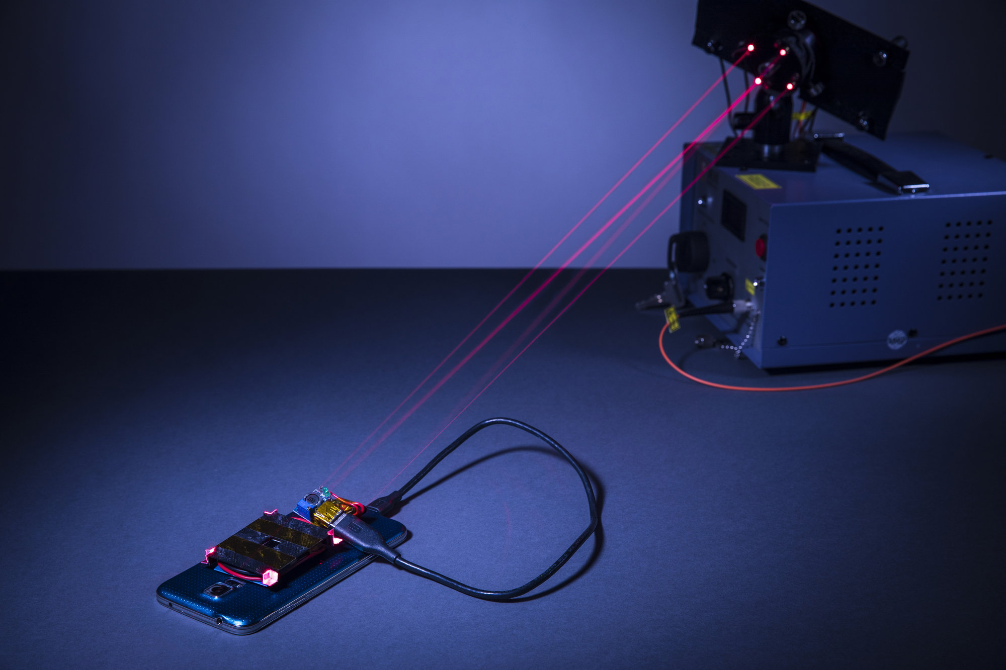
How does it work?
Power is using
safe,
focused,
beams of invisible infrared light.

Slide 9
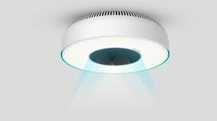
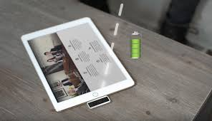
Transmitters connect - standard power source
Deliver power - nearby receivers with devices

Slide 10
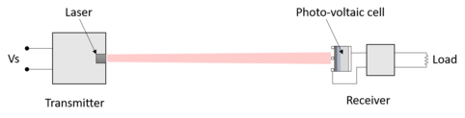
Power Delivery
Receivers - miniature photovoltaic cell
To convert transmitted light into electrical power.

Slide 11
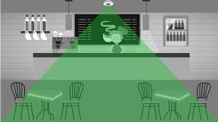
Transmitters
- automatically identify chargeable devices and
discover their power requirements. (Several devices can charge at the same time.)
Notes:
Power priority is based on power requirements, battery level and other parameters.

Slide 12
Sell services: Ceiling Transmitter & Receivers
Set up in every Buildings
To create a advanced
charging environment

Slide 13
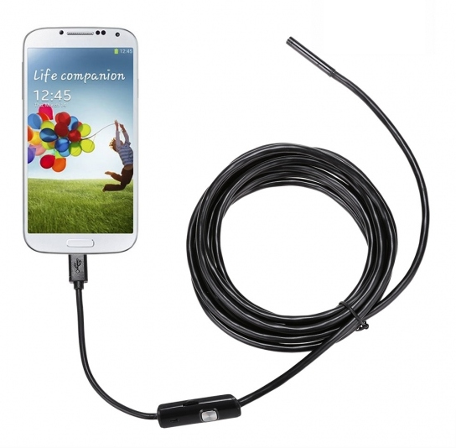
Market Analysis
Strengths
New and unique technique in the new market
Convenience
Lower battery power expense
User-friendly
Notes:
2. , wireless devices , charge the power everywhere in the place

Slide 14

Market Analysis
Weakness
High price for customers and users, hard to popularize in the normal households and low-income family
Research and development cost is very high
Weak brand name no customer base

Slide 15
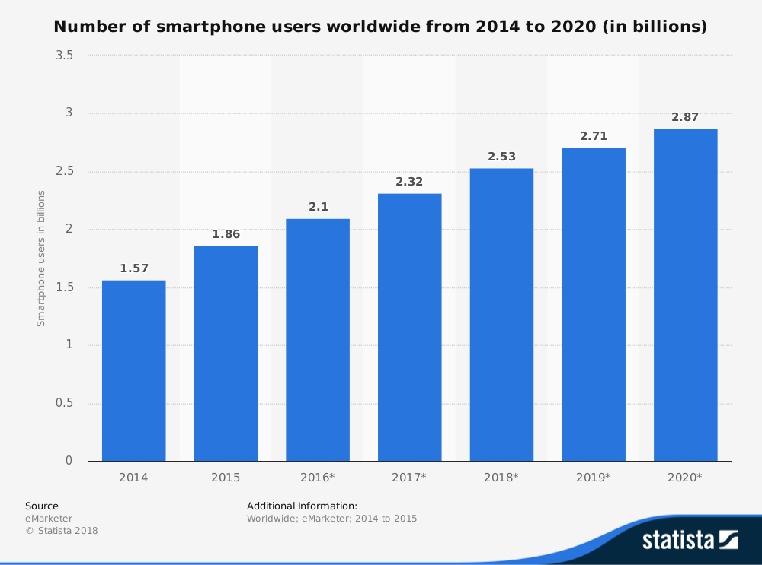
Market Analysis
External Opportunities
Large amounts of smartphones
users
Demand for power charging
Notes:
Statista :
https://www.statista.com/statistics/330695/number-of-smartphone-users-worldwide/
2.53 billions users in worldwide
Power charging is unavoidable, but can we do it in a convenient and easy way?
The user of smartphones will keep increasing, there is a great demand in power charging

Slide 16
Market Analysis
External Threats
Potential competitors create similar technique in the future
Close substitutes (e.g power bank)

Slide 17

Product/Services Development
The Process of Product/ Service Development
Notes:
Identification of an existing gap between what consumers need and what a market offers is critical in product/service development. In this case, the market does not provide a solution to repeated recharging of smart phones and tablets.

Slide 18
Product/Services Development
Key Concepts
Product/ service development should be focused on creating new markets through innovative service provisions and through assisting customers to co-create value (Gremyr et al., 2014).
Wireless and mobile devices require the users to recharge them for undisrupted service repeatedly. However, recharging through a cord is usually a challenge particularly to travelers.
Therefore, the introduction of wireless sensors to recharge the devices will differentiate the service in the market and provide solutions to customers.
Notes:
Differentiation strategy is considered to give a business a competitive advantage and thus, attracts a significant market share. Therefore, developing unique services would position the business service competitively in the market and the industry.

Slide 19
Product/Services Development
Key Objectives of Product/Service Development:
Creating unique service in the market
Attracting a significant market share in the market
Being a choice for recharging services to customers
Providing value to customers for their money
Strengthening the service brand
Developing a sustainable relationship with customers through meeting their expectations on wireless recharging
Notes:
The value proposition is crucial in influencing purchasing behavior among consumers. The wireless recharging services will provide value to customers by eliminating disruptions due to low charge on a battery.

Slide 20
Operational plan
Department
General
Rearch&Development
IT Maintenance
1.Outsourcing
2.Quality Checking (QC)
3.Stock arrangement
4.Finance
1.Price Setting
2.Potential customers
3.Make to order(MTO)
4.Direct Sales
1.Product Development
(PowerBank,Phone Case)
2.Advance Technology
(Size,Efficiency)
1.Provide maintenance
2.Analysis of broken
components

Slide 21
Order a certain amount of light or the adaptors
Set up the lights for the customers
Report the damage of the light
Repair the damage of the light
Order the products from the factory
Prepare the component that need to replace
Analyze the

Slide 22
Marketing strategy
Price
Sales for USB port : $25 each
Rental Service for Ceiling transmitter: $1300/ year
Place
University in Hong Kong (8 UGC fund University + 3 Self finance University)
Coffee Shop in Hong Kong (174 Starbucks)
Notes:
For the marketing strategy, we analyse the price, place and promotion. First, we will sell the USB port around $25. We will sell them in the University and Cafe. For example, we will set up a booth in the campus and place our products near the payment areas. Second, our target customers are the Universities and the coffee shop in Hong Kong. This is because the students and customer in coffee shop will stay there for a long time such as having a rent and reading. Therefore, they need to have a place to recharge their phone battery..

Slide 23
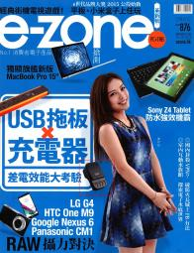
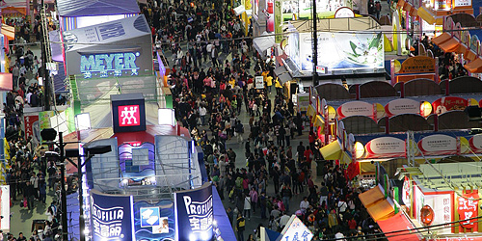
Marketing strategy
Promotion
Serval Exhibitions
E-Zone Magazine (Technological aspect)
Facebook
Advertising expensive: $150,000
Notes:
Third, we will try to promote int these aspect. That is Exhibitions,technology related magazine such as E-Zone and Facebook. The reasons are that we want to attract more customers and develop our business in the future. We need to promote specifically and save our budget. We avoid the TV advertisement but we will set a facebook channel so that more residents can also notice our products.

Slide 24
Timeline
Short term - two targets
Long term - do what

Slide 25
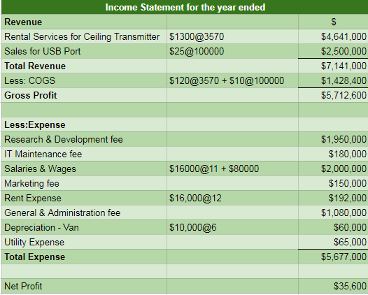
Financial statement

Slide 26
Q&A

Slide 27
Reference
Gremyr, I., Witell, L., Löfberg, N. and Edvardsson, B. (2014). Understanding New Service Development and Service Innovation through Innovation Modes. [online] Diva-portal.org. Available at: https://www.diva-portal.org/smash/get/diva2:706491/FULLTEXT01.pdf [Accessed 14 Nov. 2018].
https://ir.energous.com/financials
Statista :
https://www.statista.com/statistics/330695/number-of-smartphone-users-worldwide/

