Slide 1
Child Development
Student’s Name
Institution Affiliation

Slide 2
Introduction
Children have urges to be independent
Parents and teachers have a duty to ensure growth and independence of the child
Proper grooming and development of skills leads to self confidence
Notes:
Most children have the urge to become independent and be able to carry out tasks on their own. This is normal and important for the development of the child. The parents and teachers can help children become independent, social and understand right or wrong by allowing them to take responsibilities whenever it is possible. In most cases, this can be messy, but the kids learn a lot from doing things for themselves. When children are groomed properly for development, they gain confidence and self-esteem.

Slide 3
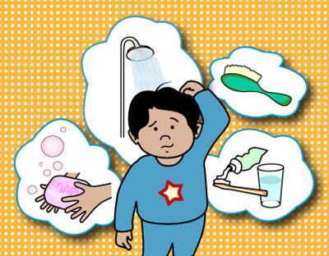
Self-help Skills
Four categories of self-help skills: self feeding, grooming, hygiene and toileting
Self-feeding- guardians help children in feeding themselves
Independent grooming- allows child to dress themselves
Notes:
There are majorly four categories of self-help skills. These include feeding, dressing and grooming themselves, proper hygiene, using the toilet and helping with daily chores (Harrison, 2003). Self-feeding is where the parents and the teachers train the child to feed themselves. This is done through practicing to use the spoon, cup and eat finger foods. Independent grooming requires encouraging the child to dress and groom by themselves by helping them pull their socks, pull out their pants and helping them put their arms through sleeves

Slide 4
Self-help Skills(Cont’d)
Train the child to get on and off the toilet seat and brush teeth
Train them on carrying out daily chores
Self-help skills enable the child to be independent
Notes:
Hygiene and using the toilet involve training the youngster to get on and off the toilet, remove and wear their clothes and wash their hands autonomously after using the toilet. Parents and teachers need to look for signs of the need to use the toilet. Teaching kids to brush their teeth is important for the parents. Helping with daily chores should involve setting up the table for children over four years and picking up toys. Children who get involved in chores as early as before four years become more independent in their early adulthood.

Slide 5
Strategies to Encourage Self-help Skills
Select appropriate prompts to help the child
In feeding choose when to help
Establish a routine that helps the child remember schedules
Notes:
Teachers and parents can use different strategies to promote self-help skills. First, they need to select the appropriate prompts. For example in feeding, the teacher or parent can move from full assistance to assisting on moving the spoon to the mouth. Additionally, they can establish a routine that enables the child to remember the schedule. For example, brushing the teeth after lunch enables the child to remember their duty

Slide 6
Strategies to Encourage Self-help Skills(cont’d)
Rewarding the child through claps and smiles
Rewards should be age appropriate
Include self-help skills in the curriculum
Notes:
Rewarding the child for being able to complete a task helps in the development. For example, when a child can go to the toilet for the first time, clapping and smiling encourage the child to continue with the habit. The rewards should be age appropriate and naturally occur in the environment. Furthermore, the self-help skills should be included in the curriculum. This will allow children practice throughout the day that enables mastery of the targeted skills.

Slide 7
Helping Parents Develop Skills in Children
Developing checklists
Both parent and child conduct rating
Providing parental programs
Notes:
Parents with kids above the age of four can develop a checklist that helps in determining how well the child has completed a chore that is assigned. Have the child rate themselves as you also rate them then compare the two in a fun and encouraging way. Additionally, providing parental programs that explain the how to develop the self-help skills in children will be necessary

Slide 8
Positive Parenting Connection Web-based Resource
Collection of resources for parents
Provides parenting books, coaching and classes
Brings out children who are confident and independent
Notes:
Positive parenting connection is a collection of resources for parents with small babies, toddlers, and preschoolers. The web resource provides parents with parenting books, coaching, and classes and alternatives to punishment for children learning the self-help skills (Brill, 2018). The web-based resource has enabled most parents to bring up children who are confident and independent through the step by step training it offers parents.

Slide 9
Pro-social Skills
Voluntary actions for helping others
Types of pro-social skills: helping, sharing and cooperating
Help child in recognizing need for help and actions to take
Notes:
Pro-social skills and behavior involve the voluntary actions that are meant to help another person in a group of individuals. The three main types of pro-social skill are sharing, being cooperative and helping others. Children develop these skills early in their toddler age. The teachers and parents need to train the children to recognize a person in need of help, decide which action to take in helping the person and lastly act by executing the necessary behavior.

Slide 10
Strategies To Develop Pro-social Skill
Pro-social skills do not come naturally
Ensure child has enough active play
Playing encourages sharing and helping
Notes:
Pro-social skills do not come naturally to everyone. The teachers and parents need to develop them using different strategies. First, they need to ensure that the children are involved in active play with the guardians and other children. Sharing and helping are usually part of active play. For example, a child may want to play with a toy owned by another child. Training the child to share their toys helps them become generous adults and accept help when necessary

Slide 11
Strategies to develop pro-social skill(Cont’d)
One-on-one time with the child
Teacher is a source of stability that the child can lean and rely on
Help the child be a better person
Notes:
Having one-on-one time with the child is an important strategy in developing the pro-social skills of a child. The teacher becomes the source of stability for the children. They can lean on, rely on and need the teacher even when they are at home. The one-on-one strategy helps the teacher encourage the child to be a better person

Slide 12
Helping Parents Develop Pro-social Skills
Pro-social starts from parent-child bond
Parent should meet the emotional and physical needs of the child
Observe what the child listens to and use corrective discipline
Notes:
Parents need to understand that pro-social skills start with the parent-child bond. Additionally, understanding that meeting the emotional and physical needs of a child contributes to developing these skills will allow parents work hard at ensuring their kids have the right social skills. Therefore, parents need to know that their children learn pro-social skills from watching, listening and chance teaching that involves observations during playtime or when watching the TV. Additionally, parent need to know of fair, firm and consistent forms of discipline as they influence the pro-social skills of the child

Slide 13
Resource For Training Parents On Pro-social Skills
Davidson Institute helps parents in developing pro-social skills
Provides books and videos on growth of children
Available on YouTube, Twitter and Facebook
Notes:
Parents need more training on maintaining pro-social skills that will help in their children’s development. The Davidson Institute is a web-based resource that provides parents with tips on how to help their children make and keep friends (Davidsongifted.org, 2018). The resource provides books and videos on kids growth, interactions, and bullying that help parents teach their kids how to be friendly and avoid bullies. The resource is available on the social internet sites such as Facebook, Twitter, YouTube, and Pinterest.

Slide 14
Self-regulation Skills
Involves management of emotions and behavior
Training children to be calm, adjust to changes and resist upsetting emotions
involve children in planning
Notes:
Self-regulation skill is the capability to manage an individual’s emotions and behavior depending on the situation (Harrison, 2003). Training children both at home and school on resisting emotional reactions that are upsetting, calming them down and helping them adjust to changes is important for their lives into adulthood. Self-regulation skills help children achieve goals as they grow up. At school, children need to be involved in pretend play and planning activities. Additionally, parents should involve the children in the planning process since it develops self-regulation skills.

Slide 15
Teaching Self-regulation At School
Use yoga to calm the body
Teachers use brain breaks after a taxing task
Use check-ins to show emotions
Notes:
In the classroom, children can be taught self-regulation skills through yoga that will calm the body and mind of the child in stressful situations. Additionally, teachers can use brain breaks after the children have been involved in a taxing activity. For example, pretending to be a windmill will be fun and relaxing for children. Teachers also use check-ins that provide the children with an opportunity to express how they feel.

Slide 16
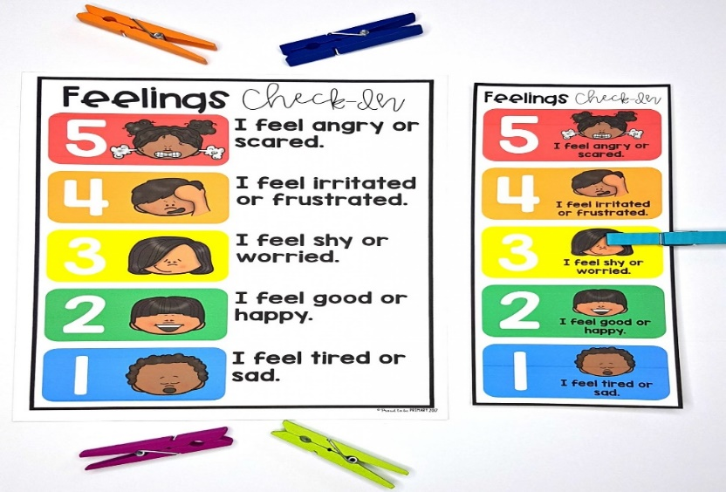
Teaching Self-regulation At School(Cont’d)
Most preschool classes have check-in charts
Child is meant to peg their feelings towards a situation
Balloon breathing helps in calming down
Notes:
Most teachers provide check-in charts showing different emotions. The children are supposed to peg the feeling they have towards a certain situation. This helps in managing the emotions and behaviors that could arise. Furthermore, calm-down kits help children in managing their emotions. For example, provide them with journals, coloring books and glitter bottles that show different emotions. Balloon breathing helps calm down children. Therefore, it is important for teachers to have them in the classroom.

Slide 17
Parents using the Self-regulation Strategies
Modelling self-control in talking and acting
Develop predictable routines for the child
Limit play time with impulsive children
Notes:
Parents can train their children on self-regulation through modeling self-control and regulation in how they speak and act. Therefore, when a parent feels angry or anxious, it is important first to walk away and calm down. Additionally, parents need to have predictable routines just like those in the classroom. This will help in structuring the behavior of the child. The parent needs to limit the time the child plays with impulsive kids since they escalate their behavior and influence the other calm kids.

Slide 18
Resource for Self-regulation
Age of Montessori is an online resource
Offers parental lessons and tests
Provides videos and books on self-regulating skills
Notes:
The age of Montessori is an online resource for teaching parents and teachers on how to ensure children have self-regulating skills. It offers parents lessons and tests to ensure they are training their children properly. Additionally, they provide the teachers and parents with e-books and YouTube videos on different topics that involve child development. Therefore, this resource is very important in developing regulation skills in kids.

Slide 19
Conclusion
Child development to adulthood needs effort
Developing necessary skills at the right age helps build confidence
All skills help the child be aware of themselves, be independent and cope with situations
Notes:
The development of a child from a baby to being a teenager and later a grown adult requires a lot of effort from both the parents and the teachers. Therefore, it is important to develop self-help skills when the child is young between the ages of two to five years. Additionally, developing the pro-social skill helps children maintain a social life even later in life. Lastly, parents and teachers need to train children on self-regulation skills to ensure that they can cope with different situations.

Slide 20
References
Brill, A. (2018). Giant List of Self-Care Skills for Babies,Toddlers and Preschoolers. Positive Parenting Connection. Retrieved 8 January 2018, from https://www.positiveparentingconnection.net/giant-list-of-self-care-skills-for-babiestoddlers-and-preschoolers/
Harrison, J. (2003). Understanding children: Foundations for Quality. Camberwell, Victoria: ACER.

Slide 21
References
Tips for Parents: How to Make and Keep Friends - Promoting Pro-Social Behavior. (2018). Davidsongifted.org. Retrieved 8 January 2018, from https://www.davidsongifted.org/Search-Database/entry/A10300

