Slide 1
Leadership and Management
Leadership and Management
Name
Institutional Affiliation

Slide 2
Effective Communication
Promote team building activities
Using handbooks to define communication processes
utilizing Electronic communication
Meetings
Proactive listening as proposed by Conrad (2014)
Notes:
Team building activities encourages openness, and it is a platform that can facilitate genuine communication and brainstorming on workplace issues. A handbook would be a suitable form of communication because it would remind the staff how to implement various processes. Electronic communication such as a whatzup group would create a communication platform where the staff and the management can share ideas. Meeting would be vital in brainstorming about upcoming issues. Lastly, proactive listening would help the staff members to understand that their opinion matters, and to offer the appropriate feedback

Slide 3
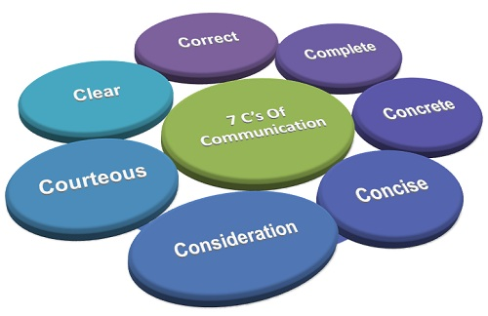
The 7cs of Business Communication: adapted from business jargons, a business encyclopedia

Slide 4
Building a Supportive and Comfortable Workplaces
Setting precise rules, regulations, policies and procedures
Offering encouragement and support
Offering praise where necessary
Creating a productive atmosphere help the employees to feel involved
Taking the needs of individual employee seriously as noted by daley (2012)
Notes:
Offering clear expectations and setting clear boundaries is a demonstration of effective leadership, and it helps in offering guidance to the employees. encouragement and support makes that employees have a sense of belonging at the institution, whereas warranted praise makes employees feel appreciated and motivated. Considering the needs of the employees is a vital support strategy.

Slide 5
Continuation
Hiring an effective team
Enhancing communication
Fostering autonomy at the workplace
Notes:
Hiring a great team makes the workplace environment friendly and bearable, while enhancing communication is a great way of understanding the needs of the employees. In the same line, fostering employee’s autonomy helps the employees to reach optimal productivity without being pressurized.

Slide 6
Career Development Opportunities for Staff
Discuss with each employee their personal interest and career goals
Encourage employees to create personal development plans
Provide platforms for training the employees on basic job competences
Support staff in identifying appropriate development plans (Rawson, 2012)
Notes:
Understanding the interests and career objectives of the employee is essential in determining the appropriate development activities suitable for them. Personal development plans would help employees to set time bound development goals and work towards their achievement. In addition, training platforms could include seminars, conferences or workshops where the employees are taught on the basics of job competence.

Slide 7
Continuation
Facilitating ample time for employees to engage in personal development activities
Facilitating employee development activities at the workplace
Notes:
Sometimes the employees may be discouraged from participating in personal development activities due to time restrictions at the workplace. Therefore, proper communication and set out policies would be essential in identifying when an employees can get time for personal development. Development activities can be incorporated in the day to day activities at the workplace by elements such as job aids, job rotation as well as job shadowing.

Slide 8
Attraction and Retention of Quality Staff
Development and implementation of an informed hiring structure
Development of defined human resource policies
Having job description and job performance evaluation (Sokro, 2012)
Fostering a workplace diversity culture
Developing a success profile
Notes:
A hiring structure is vital in establishing a job fit and promoting job satisfaction. Human resource policies guide the employees on what is expected of them and what they would expect from the ECE institution. job description upholds specialization and productivity, while embracing diversity creates cultural sensitivity at the workplace, making all the workers feel at home. Similarly, a success profile would be essential in gauging the performance of each employee alongside that of other employees

Slide 9
continuation
Fostering staff motivation
Offering an appropriate salaries and relevant benefits
Creating a friendly workplace atmosphere as proposed by Sokro (2012).
Notes:
Motivation may be of different types, and it helps to retain quality employees and stimulate their optimal performance. Appropriate salary and benefits helps in preventing quality employees from seeking greener pastures while a friendly workplace atmosphere is one way of attracting and retaining quality employees.

Slide 10
References
Sokro, E. (2012). Impact of employer branding on employee attraction and retention. European Journal of Business and Management, 4(18), 164-173.
Conrad, D. (2014). Workplace communication problems: Inquiries by employees and applicable solutions. Journal of business studies quarterly, 5(4), 105.
Rawson, D. (2012). Career counseling [Book Review]. Australian Journal of Guidance and Counselling, 22(1), 151.
What are 7 C's of Communication? definition and meaning. Business Jargons: A Business Encyclopedia. Retrieved 13 March 2018, from https://businessjargons.com/7-cs-communication.html
Daley, D. M. (2012). Strategic human resources management. Public Personnel Management, 120-125.

