Slide 1

Little Angels Paradise
Notes:
Little angels paradise offers a safe, happy and loving environment. Our focus on developmentally appropriate practices stimulates your child's holistic growth and development in key areas including physical, mental, cognitive and social areas. This is the best place for your child to be.

Slide 2

Location
1901 North Sharon Amity Road Charlotte, NC 28205
Safe and secure, accessible, friendly neighborhood
Little Angels Paradise is located in a friendly residential neighborhood in North Sharon Amity Road Charlotte. We are just next to the main road, and thus we are easily accessible.
Road distractions and traffic jams are rare in these areas.
The residential neighborhood offers a serene and homely environment where children can play and lean without distractions such as noise and pollution; which are common in non-residential areas.

Slide 3

Scope of Service
Our care centre is open from 7:00 am to 5:00 PM.
Tender babies: This a program for the babies who are between six weeks and 24 months which is based on the physical and interactive needs of the baby.
Explorers: This programs is for the toddlers and its based on fine and gross motor skills as well as the development of learning skills
Pre-kinder: This is a prekindergarten program that is mainly focused at preparing the 3-5 year olds for kindergarten. Children in this program are exposed to learning various contents through exploration and play.
l earning is fun!

Slide 4
Monthly Tuition fee $
program | 2 days | 3days | 4days | Full time
Tender babies: | 690 | 840 | 1008 | 1145
Explorers | 568 | 735 | 900 | 950
945Pre-kinder: | 502 | 645 | 755 | 810
We also charge a one-time enrollment fee of 42 $ per .
We allow a space holding fee of 25% of the tuition fee for a holding duration of 30 days.

Slide 5

Philosophy
Our philosophy entails a holistic nurturing of the child’s learning and development based on three core developmentally practices listed below
Teacher’s comprehension of the learning and developmental needs of the age-groups they are dealing with
A child-based (personalized approach to learning and development
Teachers comprehension and respect for the child’s family and cultural background (NAEYC a)

Slide 6
How we address the ten NAEYC Standards
Relationships
We establish close collaboration with the families and the child’s parents
Communication is facilitated by parents-teachers conference, meetings and learning experiences for their children
Parents are always welcome in the school, and we encourage them to be involved in the child’s everyday learning
Open administration-staff relationships are enhanced in order to avoid tension and misunderstandings

Slide 7

Curriculum
Based on the age brackets of our programs (infants- prekindergarten), our curriculum is mostly based on age appropriate practices.
The curriculums are based on social, emotional and physical lessons as well as learning skills.
Play is a vital part of our curriculums for all the programs.
We also offer numerous resources that facilitate hands-on learning (NAEYC).

Slide 8
Teaching
We employ qualified teachers who understand the learning and developmental needs of the children they are handling
The teachers employ a child-based approach to learning
They visit the children at home in order to understand the family and cultural background of each child
Teachers facilitate platforms that allows the children to make meaningful choices
They identify stress in each child’s life and support the child in reduce stress and cope with resilience
They provide appropriate experiences, resources and interactions for effective play
They set appropriate challenges for the children, in accordance to the program’s curriculum (NAEYC)

Slide 9
Assessment of Child’s Progress
Our assessment characteristic rely more on observational and work sampling approaches that are inclined to the child’s performance, processes, and product; in different periods of time, and under different contexts.
We employ Portfolio systems to keep track of various aspects of assessment.
The obtained feedback will offer directives in making the necessary rectification and thus ensure continuous quality.
Feedback form parents is also useful in or assessment characteristics

Slide 10

Health
We have a child care health consultant (CCHCs) who work hand in hand with the care centre’s staff to ensure health and safety environmental in our facility.
The CCHCs evaluate the health and safety requirements and procedures and advice the care centre on appropriate actions
They establish strategies for inclusion of children with special care needs
Manage and prevent injuries and infectious illnesses as noted by the North Carolina Child Care Health and Safety Resource Center

Slide 11

Teachers
We offer a conducive working environment for the care givers in our facilities
We offer them an attractive salary and benefits
We take them on a one week vacation every year
We offer them time to engage in personal development
We facilitate open communication channels in order to identify the needs of every teacher
Ours is a heavenly team that enjoys working in the best organizational culture ever

Slide 12
Families
We ensure that the child’s family is actively involved in every step of the child’s learning and development
Our teachers meet the children at home in order to understand the family backgrounds of each and every child
We respect the culture, customs and beliefs of every child
We maintain regular communication and collaboration with every child’s family.
The IP cameras installed in our care centre exposes the parents to the child’s day time activities.

Slide 13
Community relationships
We endeavor to identify with the cultural values, expectations and customs as well as linguistic traditions of every child
This helps us to ensure that the learning experience we offer in our programs are relevant and respectful for individual children and families
Meeting the children where they are a vital element of our programs that helps the care givers to identify with cultural background of every child.
We offer a validated curriculum model and associated professional developments in order to assist the teachers to adapt to the cultural diversity of every child; as recommended by NAEYC

Slide 14

Physical Environment
Our programs offers indoor and outdoor leaning experiences
We have sufficient indoor and outdoor play resources that facilitate physical development and cognitive learning experiences
Our indoor and outdoor environments offer a spacious, warm and homely environment
Various learning and play resources are placed at strategic places in order to facilitate exploration and experimentation e.g sand boxes, gardens, shelves, among others.
We hold educative trips in order to expose the children to natural features such as rivers and lakes that are not within the vicinity of our facility
We always endeavor to ensure that our physical environment is aligned with our centre’s philosophy

Slide 15
Leadership and Management
We always encourage our staff to engage in professional development
Recently, the school invited the NAEYC staff members to take out care givers through the developmentally appropriate practices.
Our staff members were able to ask questions in area they felt inadequate.
This seminar was essential in refreshing our staff’s conversancy with the NAEYC developmentally appropriate practices

Slide 16
Testimonial from a Satisfied Parent
Every parent wants a place where they can feel safe leaving their children. I got this place in Little Angels Paradise. My child has been in this care centre for three years since she was an infant; and I can assuredly say I am impressed with their services
I would advice any parent to bring their child to Little Angels Paradise it is the only place that has offered me satisfaction in terms of caring for my child. They maintain regular communication and allow us to be a part of our child’s learning and development

Slide 17
Daily Schedule
7:00 am- 8:00 am- children arrive at care centre
8 am:8:30am- health checks, hand washing, and free play activities
8:30 am-9:00 am- singing, finger play, music and movement
9:00 am-9:30 am- snack time
9:30am-10:30 am- all indoor play areas are open for children to explore and experiment
10:30 am-11:30 am- outdoor activities (painting, sand and water play, racing, riding etc)
11:30 am-12:30 pm- lunch time
12:30 pm-1:00 pm- circle time (discuss the upcoming event)eg weather, news etc)
1:00 pm-3:00 pm- afternoon naptime
3:00 pm- 3:30 pm- snack time
3:30 pm-4:00pm- tidying and preparing to go home

Slide 18
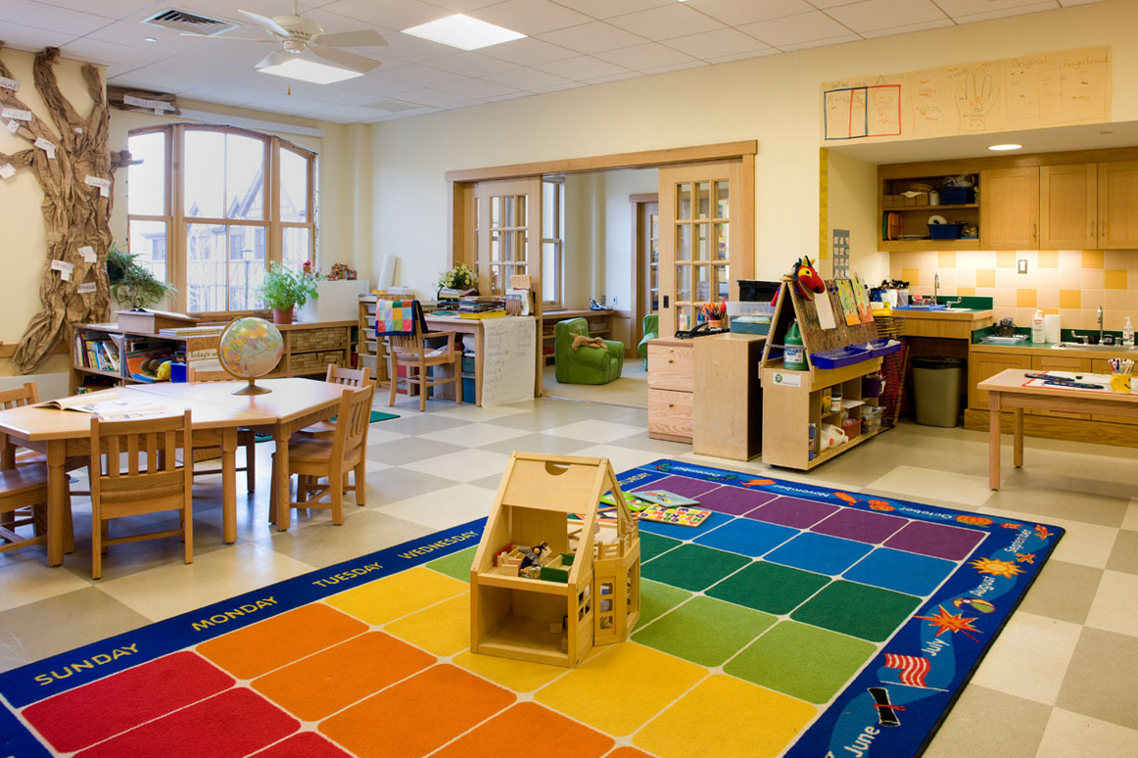
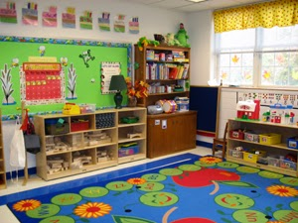
Classroom
Photo Courtesy of Clip Art

Slide 19
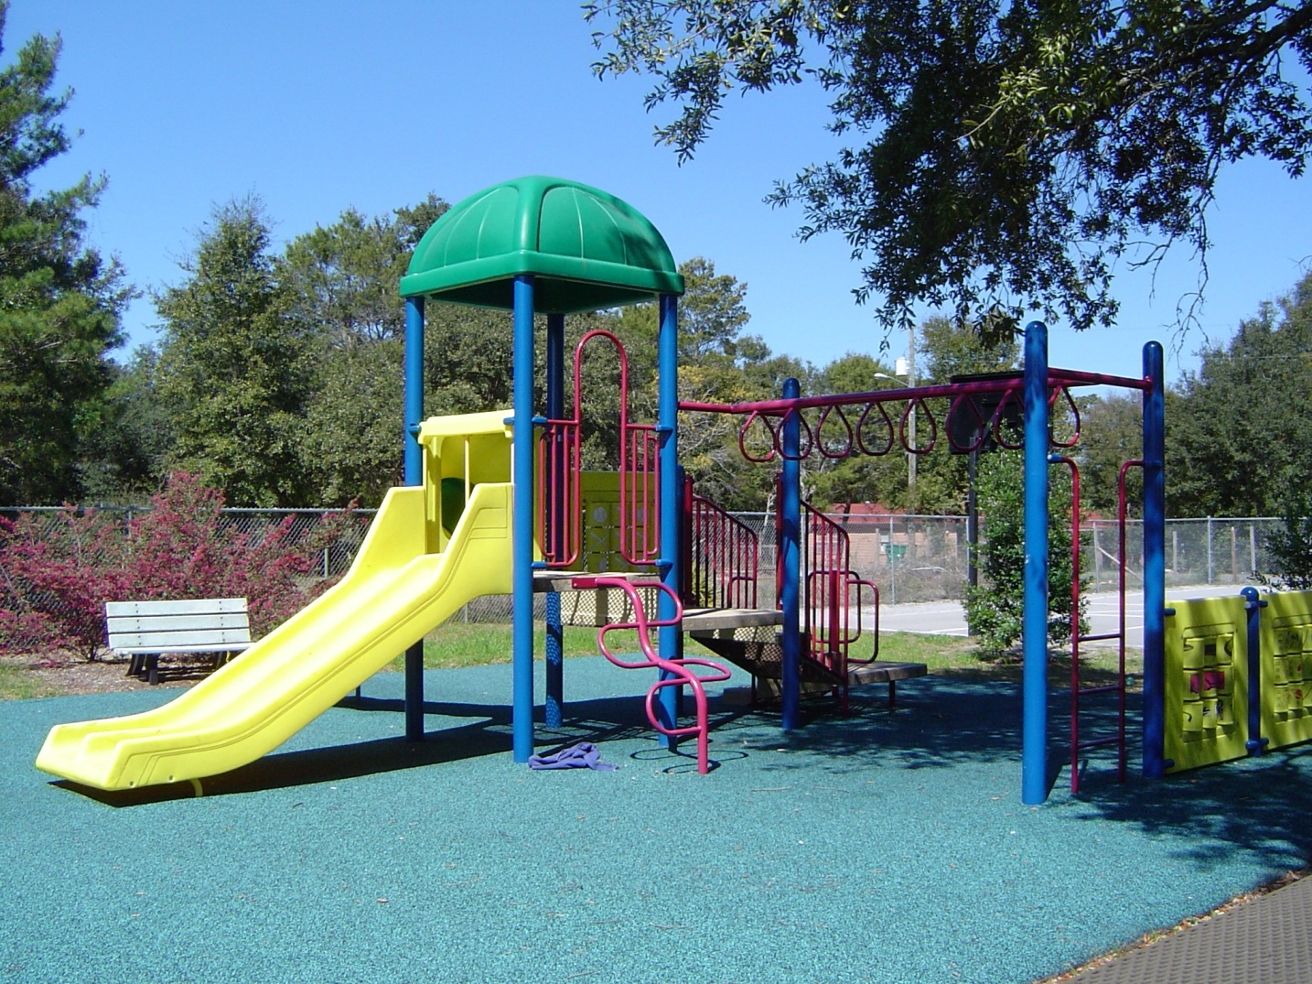
Playground
Photo Courtesy of Clip Art

Slide 20
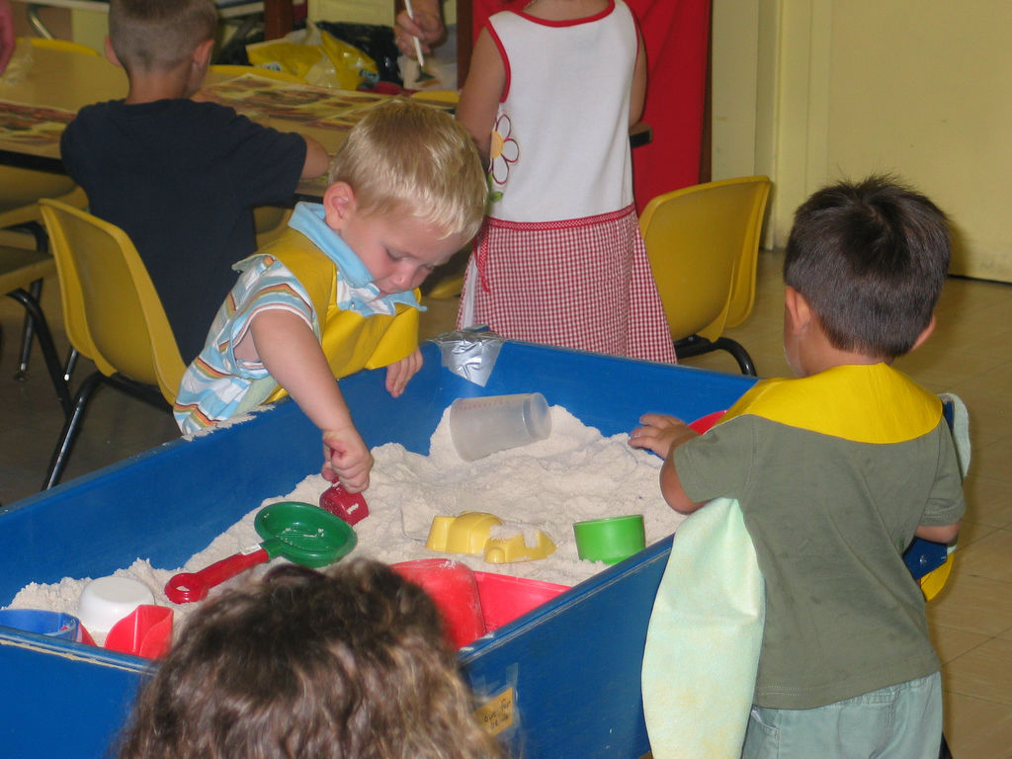
Classroom
Photo Courtesy of Clip Art

Slide 21

Classroom
Photo Courtesy of Clip Art

Slide 22
Menu
Day | 9:00am Snack | Lunch | 3:00 pm Snack
Monday | Cereal with milk A slice of water melon | Fish Brown rice Steamed carrot sticks milk | Cheese and crackers Sliced peaches
Tuesday | Whole grain backed pancakes milk | Soft chicken taco Whole wheat rolls Broccoli Sliced grapes milk | Fruit salad Yoghurt
Wednesday | Yoghurt oranges | Spaghetti Beef stir-fry Tomato slices Sliced strawberries milk | Whole wheat cereal with milk
Thursday | Oatmeal Apple slices milk | Stuffed potatoes Sliced carrot sticks Sliced pineapples milk | Cheese and crackers Banana slices
Friday | whole wheat muffins with cheese | Whole wheat bread Shredded lettuce and tomato slices Pieces of kiwi milk | Graham crackers Sliced peaches Yoghurt

Slide 23
Website Critique: Bright Horizons
No contact information if offered on the home page
The website has a .com in its URL
The website does not indicate the date which the pages were created
Some vital information such as the tuition fee is lacking from the website
Easy to navigate to other pages from the home page
The website offers relevant information, the audience is the parents/guardians
Use of illustration (images) is useful to the audience

Slide 24
website evaluation rubric

Slide 25
References
Developmentally Appropriate Practice (DAP) Introduction | NAEYC a. Naeyc.org. Retrieved 19 March 2018, from https://www.naeyc.org/resources/topics/dap
(2009). Naeyc.org. Retrieved 19 March 2018, from https://www.naeyc.org/sites/default/files/globally-shared/downloads/PDFs/resources/position-statements/PSDAP.pdf
Bright Horizons Child Care | Preschool & Early Education Programs | Bright Horizons®. Brighthorizons.com. Retrieved 19 March 2018, from https://www.brighthorizons.com/
Menu Planning in Child Care Centers. Health Unit Haldimandi Norfolk. Retrieved 19 March 2018, from https://hnhu.org/wp-content/uploads/Child-Care-Centre-Menu-Planning-Toolkit-REVISED.pdf
North Carolina Child Care Health and Safety Resource Center. (2018). Healthychildcarenc.org. Retrieved 19 March 2018, from http://www.healthychildcarenc.org/?page=cchc

