Slide 1
The In-Store Buying Experience-Forever 21
Name:
Institution:
Date

Slide 2
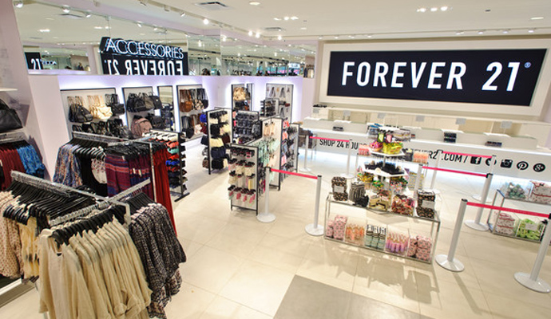
Store Branding
Customers easily identify with the brand
The company Is able to differentiate itself with brands in the similar industry.
Make the brand unmistakable for the customers
Butterboom.com
Notes:
Store branding is an important advertising tool for retail companies because it not only makes the brand known to the consumers but also enable the consumers to differentiate the company’s brand with that of the competitors in the industry. Store brands also have a positive impact on the company’s overall image in the sense that the prices and the values in the store reflect to the company’s brand image(Kremer, 2012). It also increases brand awareness in the market.

Slide 3
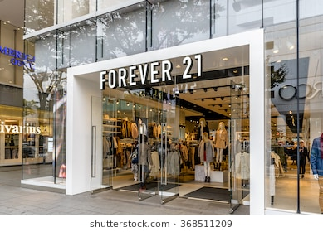
Store Exterior
Enhance visibility of products
Convenience for target customers.
Contributes to the customers’ shopping experience
Notes:
The design of the exterior of a shop engage customers with the company’s products as the store makes the products visible to the customers .For instance, most Forever 21 shops have large glass windows to enable their target customers to have a sneak peek of what is inside the shops. It is a way of influencing their target customers to enter the shop and purchase the products. The windows also allow enough lighting in the shops which allows customers to have a good shopping experience.

Slide 4
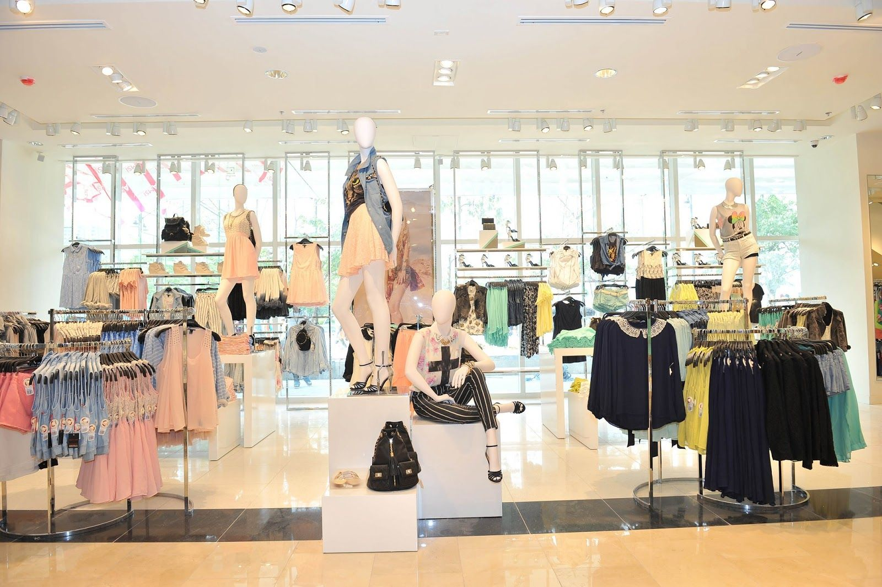
Store Layout
Pintrest.com
Customers are able to get the desired product easily.
The partitions and arrangement of attires make the shopping experience easy and interesting.
Notes:
The store layout of Forever 21 is designed in a way that the men, women and kids sections are separate and clearly identified which helps the customers have an easy shopping experience and to get their desired product easily. The store layout also has a wide customer path which is designed to accommodate strollers and also enhance the interior image of the store. Therefore, customers are able to walk around comfortably without feeling constricted in any way.

Slide 5
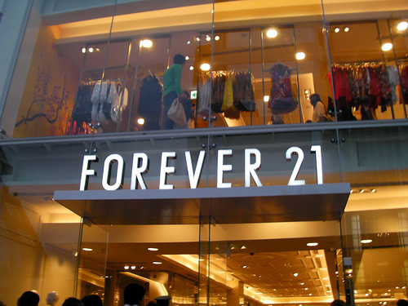
Store Signage
Msmagazine.com
Gives customers a memorable first impression about the brand.
The window displays promote the brand.
Influence the purchase decisions of customers.
Notes:
A store signage is an opportunity for companies to promote their brand. It is also a way to promote the company’s identity and also give first time customers an impression about the brand and give them a memorable first impression(O'Donnell & Yarrow,2013). Forever 21 understands this concept as most of the company’s retail store have a signage with the name of the company as well as window displays which are meant to help promote the clothes to the target customers as well as influencing their purchase decisions.

Slide 6

Store Departments
Twitter.com
Forever 21 stores have four different departments;
Women
Men
Plus size
Kids
Notes:
Forever 21 has four different departments that cater for the different needs of their customers in the market. The departments are found in different sections of the store where the merchandise are arranged in a way that is easy for the customers to identify what they want to purchase. The fact that these departments promote convenience for shoppers enhance the overall brand image of the company hence allowing the company to acquire a large market share in the fashion industry(Plunkett,2008).

Slide 7
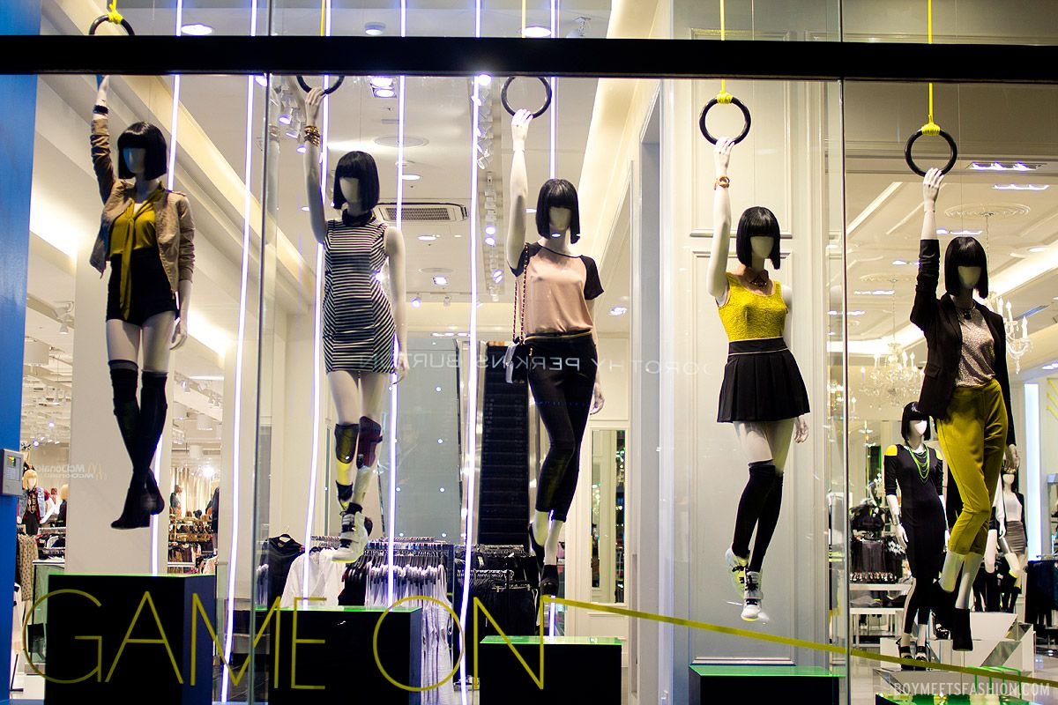
Store Traffic Design Strategy
Great window displays
Great website
Gettyimages.com
Notes:
The strategies in forever 21 store designs that seem to guide shoppers are the company’s great window displays and website(O'Donnell & Yarrow,2013)The company’s website specifically has procedures that make it easy for the shoppers to identify the products that they want to purchase. The window displays allow the customers to identify what they will get from entering the store. This is a strategy of attracting specific type of customers that the company aims to get.

Slide 8
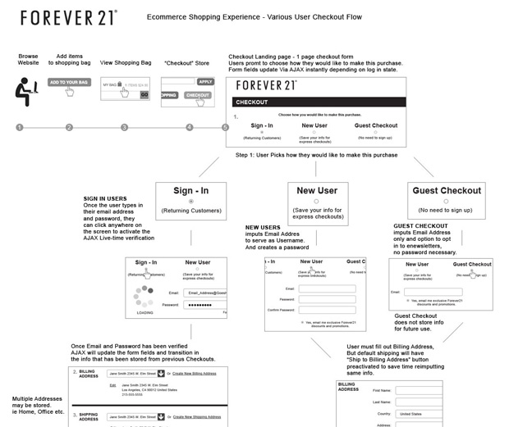
Purchase process
Beyondtheblur.com
They have sales associates in their physical stores to assist customers.
The online platform also has step by step guides of the purchasing process.
Notes:
Forever 21 products are mainly trendy fashion items meaning that the demand for their clothes and accessories is high. Thus, their trendy items satisfies the need of most customers. However, to ensure that a purchase is made, forever 21 stores have sales associates that assist customers while doing their shopping and influence their purchasing decisions. The online shopping at Forever 21 also has easy steps that customers can easily follow while making their purchases.

Slide 9
Summary
Some of the aspects discussed such as store branding, store signage and store exterior all play a significant role in the marketing of Forever 21 products.
The store signage and branding are crucial in communicating to the target customers the products available in a company’s retail store.

Slide 10
References
Kremer. F.(2012). How store brands build retailer brand image. International Journal of Retail and Distribution Management. 40(7).
O'Donnell, J., & Yarrow, K. (2013). Gen buy: How tweens, teens and twenty-somethings are revolutionizing retail. San Francisco, Calif: Jossey-Bass.
Plunkett, J. W., & Plunkett Research, Ltd. (2008). Plunkett's apparel & textiles industry almanac 2008: The only comprehensive guide to apparel companies and trends. Houston, Tex: Plunkett Research.

