Slide 1
Self-Driving Car
Student’s Name:
Professor:
Course:
Date:

Slide 2
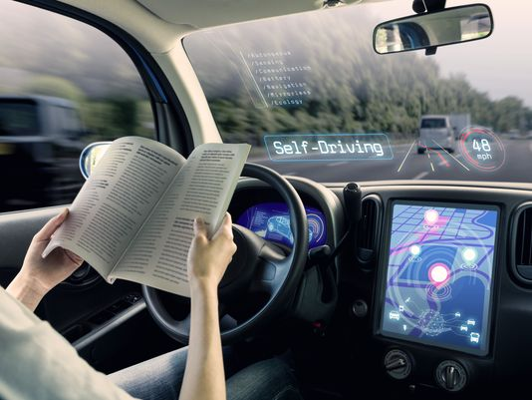
Introduction
A self- driving car/ autonomous car is a vehicle that navigates without human input. Instead, the car uses a combination of radar, sensors, cameras and artificial intelligence to detect the surroundings and move between destinations(Maurer,2018.

Slide 3
Brief History
The prospect of self-driven vehicles may be dated back to the 1500’s when Leonardo Di Vinci developed a self propelling cart
The concept of self-driving cars began with increased safety and convenience automation features before the millennium.
Advanced features such as blind spot detection, electronic stability control and lane shift warnings became available during this period.
Between 2010 to 2016, advanced driver assistance capabilities became available.
The most recent development of the self-driving car is by Google and Tesla.
Notes:
The path towards self-driven cars began with increased automation features such as anti lock brakes and cruise controls. However, it is between 2010-2016 that major advancements took place leading to the establishment of self-driven cars. According to the NHTSA, the advancement included the emergence of rearview cameras, electronic stability features and blind spot detection features (Maurer,2018). The most recent development of self-driven cars is that by Tesla which is knows as Tesla autopilot. Google has also developed its own automated car knows as Waymo.

Slide 4
Automation Levels
According to the U.S National Highway Traffic Safety Administration(NHTSA), there are six levels of automation beginning with zero.
In level zero, people do the driving using the driver assistance technologies.
The levels that follow zero automation include;
Level 1 Level 4
Level2 Level 5
Level 3
Notes:
Level 0- very little automation but has driver assistance technologies.
Level 1-Has advanced driver assistance system (ADAS) which helps the driver in steering, braking or accelerating but not simultaneously. It also has rearview cameras.
Level 2-Has the ADAS which enable the driver to brake, accelerate or steer simultaneously.
Level 3- The ADAS performs all the driving tasks in certain circumstances such as parking the car.
Level 4- The driver does not perform any tasks since the ADAS performs the driving tasks and monitors the surroundings.
Level 5- The ADAS does all the driving in all circumstances and the driver does not have to perform any tasks.

Slide 5
How the Self-Driving Cars work
The self-driving cars use the data from image recognition systems such as cameras and sensors together with neural networks and machine learning to build an autonomous driving system.
The systems create an internal map for the vehicles surroundings.
The vehicle’s in-built software processes the inputs and sends instructions to the vehicle’s steering, acceleration and braking systems.
Notes:
To understand how the self-driven cars work, we look at Google’s Waymo. The car utilizes the cameras, the sensors, light detectors and combines all the data obtained to identify everything around the vehicle. The car’s software also includes Google Maps that enable the car to identify things such as traffic lights, landmarks and lights. The driver can also take control of the car by overriding the ADAS function.

Slide 6
Competition
Many companies are working on the prototypes of self-driving cars.
The prototypes have different levels of autonomy.
The companies manufacturing the self-driving cars include; Mercedes Benz, Tesla Motors, Google, Audi, Volvo, Hyundai Motors, Renault and Nissan.
Notes:
Following the tremendous advancement of technology in the recent years, most auto companies have taken the initiative to work on self-driven car prototypes. These prototypes vary with the level of autonomy hence some of them require the driver’s help and attention. As of now, the popular prototypes of the self-driven cars include Google’s Waymo and Tesla’s autopilot. Hyundai has a strategic partnership with Aurora to enable the company to develop software and hardware of automated cars by 2021.

Slide 7
Ethical Challenges for Self-driving Cars
Self-driven cars present a new dilemma; Whom should the vehicle save and whom should it harm when an accident is unavoidable? Do the elderly or children change the equation?(Goldhill,2018)
Automated cars often face the challenge as to whether to prioritize the lives of the passengers or of the pedestrians
Notes:
These ethical dilemmas portray the challenges that the manufacturers of the self-driven vehicles face when it comes to programming the cars. This is to ensure that the safety of both the passengers and pedestrians are not compromised. As such manufacturers are coming up with safety measures by programming the vehicles to hit on objects rather than pedestrians to minimize the risks. However, this means risking the lives of the passengers hence the manufacturers need to embed ethical principles that will act as guidelines in situations of unavoidable harm.

Slide 8
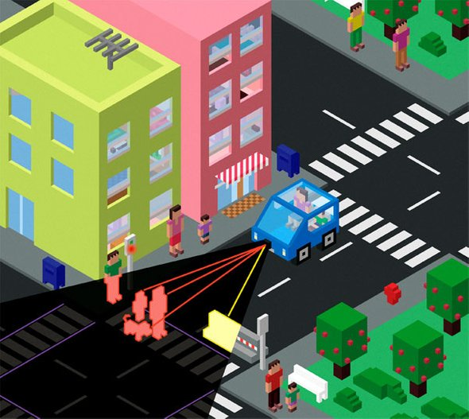
Ethical Challenges at Crosswalks
Scientificamerican.com
The ethical challenges deepen in mundane situations such as intersections, crosswalks or turns.
In such cases, the automated vehicles have to make decisions that minimize harm (Himmelreich, 2018) .
Is it permissible to cause harm to others to prevent harm to others?
Notes:
Crosswalks, turns or intersections pose greater ethical challenges for self-driven cars. To anticipate such extreme cases, it would be better for the manufacturers to incorporate software that include guidelines in such situations of unavoidable harm to prevent harm to others and the passengers as well. Philosophers are also building ethical algorithms to solve the problems

Slide 9
Pros of Self-driven Cars
Promote safety
Reduce traffic congestion
Fewer accidents
Lower fuel consumption
Enhanced Human Productivity
Enhanced mobility for the elderly, children and the disabled.
Notes:
In as much as the self-driven cars pose great ethical challenges, they have numerous advantages. For instance, they promote the safety of the passengers by reducing the number of accidents caused by human error. They also help reduce traffic congestion since they can be programmed to space out automatically hence eliminating the behavior of selfish drivers on the roads. Furthermore, eliminating traffic congestion would help save the fuel altogether. The cars would also enable people to tackle some tasks such as responding to emails while on the road hence enhancing productivity especially for busy executives. The other benefit is that it would enable the mobility of people who cannot drive such as the disabled, children and elderly since they only have to set their destinations.

Slide 10
Cons of Self-driving cars
Hacking problems
Ethical issues
Computer malfunctions could cause serious crashes
Increased unemployment for drivers
Problems related to weather
Notes:
Following the amount of technology that the self-driven cars use, they are easily susceptible to hacking which may cause malfunction and result in serious crashed. Another disadvantage would be on the effect it would have on the drivers) 8 (Maurer,201. Their skills may not be required once these vehicles saturate the market hence raising unemployment rates. Furthermore, bad weather conditions may affect the laser sensors and the cameras having a great impact on the functioning of the car.

Slide 11
Conclusion
Overall, the self-driving car market has potential but a lot needs to be done to eliminate the negative aspect of the cars.
There are a lot of opportunities for developments, improvements and innovation regarding the self-driving cars especially following the tremendous advancement in technology in the recent years.

Slide 12
References
Goldhill, O. (2018). Philosophers are building ethical algorithms to help control self-driving cars. Quartz.com. Retrieved from https://qz.com/1204395/self-driving-cars-trolley-problem-philosophers-are-building-ethical-algorithms-to-solve-the-problem/
Himmelreich, J. (2018). The everyday ethical challenges of self-driving cars. Theconversation.com Retrieved from https://theconversation.com/the-everyday-ethical-challenges-of-self-driving-cars-92710
Maurer, M., Gerdes, J. C., Lenz, B., Winner, H., & Springer-Verlag GmbH. (2018). Autonomous Driving: Technical, Legal and Social Aspects.

Slide 13
Thank you for your Attention

