Slide 1

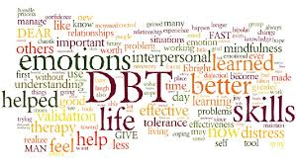
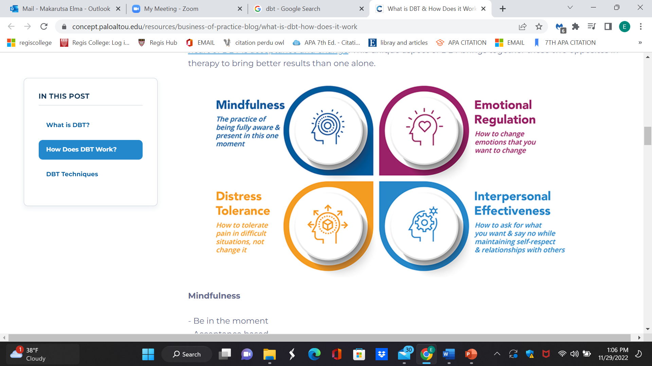
Psychiatric Disorders In Dialectal Behavioral Therapy
Prevalence and Evidence-Based Treatment Considerations
Name: Elma Makarutsa
Abstract
Dialectical Behavior Therapy (DBT) prioritizes suicidal behavior and other self-directed violence and suicidality, including suicide attempts, non-suicidal self-injury (NSSI), and suicidal ideation as the primary treatment targets. CBT has been shown to reduce self-directed violence as well as the incidence of mental crises (Barcan, 2020). .
Overview
DBT is a type of cognitive-behavioral therapy that focuses on the psychosocial aspects of treatment. The underlying concept of DBT is that certain people are more likely than others to react strongly or strangely to specific emotional conditions. Relationships with family, friends, or love partners are the most prevalent source of these emotional events. According to the theory, certain people's arousal levels rise faster and more powerfully than the average person's. DBT teaches these high-arousal persons how to handle this emotional influx (Barcan, 2020). .
Three primary components
(DBT) assists patients in identifying thoughts and convictionsSupportive-Oriented: DBT aids a person in discovering and improving their distinctive qualities in order to increase their self-esteem and self-image
Cognitive-Behavioral Therapy that make life more difficult for them, such as "I have to be faultless." As a result, they have new perspectives on life, which makes things easier for them.
Collaboration: DBT promotes dialogue between the patient and the therapist. Clients and therapists work together to resolve relationship issues in DBT. Patients participate in role-playing activities, complete homework, and work on coping techniques. To do all of this, the patient and therapist collaborate closely.
Background
Dialectical behavioral therapy was developed for the first time by psychologist Marsha M. Linehan in the late 1980s. Dialectical behavior therapy, or DBT for short, is a type of cognitive behavioral paradigm used in psychotherapy. It was initially developed to help with the treatment of borderline personality disorder. It is a highly effective form of therapy that aids in the treatment of a wide range of mental health issues, including depression, borderline personality disorder, and other disorders (Barcan, 2020). .
Evidence-Based Practice
One method for assisting service members to keep themselves safe when they have suicidal thoughts is dialectical behavior therapy (DBT). DBT is advised in the Clinical Practice Guideline for the Assessment and Management of Patients at Risk for Suicide. Assessment and Management of Patients at Risk for Suicide is an evidence-based treatment for those who have suicidal thoughts, attempts, or self-harming activities. DBT is a sophisticated technique that combines aspects of cognitive behavioral therapy and teaches people how to control their emotions, handle stress, and communicate with others (Mann et al., 2021).
Current Trends
Few apps are available for clinicians to offer DBT. DBT-based mobile apps may be helpful in expanding access to care and enhancing in-person DBT. In order to create a mobile app that is both highly functional and clinically appropriate, a tighter collaboration between DBT experts and app developers is required. Which components of DBT given through apps improve treatment outcomes, as well as the degree to which technology integration into DBT is necessary or most beneficial (Wilks et al., 2021).
Treatment Guidelines/ Recommendations
DBT treatment regimens usually included sessions of both skills group therapy and individual therapy. The client will work with a therapist to integrate DBT techniques into their daily activities and to deal with any problems that arise throughout treatment. DBT group therapy teaches and practices skills in small groups. Many clients offer help and share their experiences. A therapist leads the group, instructs skills and guides everyone through the process.
Individual Psychotherapy Sessions:
Individual treatment sessions are held on a weekly basis. The purpose of therapy is to assist patients in learning and practicing adaptive behavior. Rather than attempting to remove clients from emotionally charged situations, they aid clients in coping with emotional trauma.
Group Psychotherapy Sessions:
he sessions are led by a DBT-trained therapist and they typically run 2 and half hours weekly. People learn one of the four modules during group DBT. They get the opportunity to discuss and practice skills taught during individual DBT sessions.
(DeCou et al., 2019).
Populations
The specific population that best benefits from this therapy include
Borderline personality disorder
Eating disorders
Self Harm
Depression
Suicidal thoughts
Notes:
Title sections should be: Abstract, Overview (definition of the therapy modality, main points or guides), Background (background of therapy modality, theories, developers), Evidence (EBP for use), Populations, Current Trends, Tx Guidelines/ Recommendations

Slide 2
References
Barcan, R. (2020). Complementary and Alternative Medicine. Dialectical Behavior Therapy for Men With Borderline Personality Disorder and Antisocial Behavior: A Clinical Trial. https://doi.org/10.4324/9781003084990
DeCou, C. R., Comtois, K. A., & Landes, S. J. (2019b). Dialectical Behavior Therapy Is Effective for the Treatment of Suicidal Behavior: A Meta-Analysis. Behavior Therapy, 50(1), 60–72. https://doi.org/10.1016/j.beth.2018.03.009
Mann, J. J., Michel, C. A., & Auerbach, R. P. (2021). Improving Suicide Prevention Through Evidence-Based Strategies: A Systematic Review. American Journal of Psychiatry, 178(7), 611–624. https://doi.org/10.1176/appi.ajp.2020.20060864
Wilks, C. R., Gurtovenko, K., Rebmann, K., Williamson, J., Lovell, J., & Wasil, A. R. (2021). A systematic review of dialectical behavior therapy mobile apps for content and usability. Borderline Personality Disorder and Emotion Dysregulation, 8(1). https://doi.org/10.1186/s40479-021-00167-5

