Slide 1

News Literacy
CHAPTER 2

Slide 2
Introduction
Bias develops from opinions, values, and beliefs.
Bias is unavoidable.
How we deal with and use our biases is what matters.

Slide 3
Biases Within the Media
Common types
  Political bias—a story or news event is altered to make a political position more attractive to the listeners or readers
  Ideological bias—information is shaped to mirror an opinion, belief, or cause the media outlet supports.
  Bias that extends to the point of becoming a lie
Developing media literacy to identify bias
  Words used
  Scope of information
  Framing

Slide 4
Forms of Bias
Liberal bias
  Associated with political left
Conservative bias
Libertarian bias
  Associated with political right
Mainstream media bias
Corporate bias
Activist or cause bias
Gatekeeping bias

Slide 5
How Do We Detect Bias?
Bias within the news and media
Bias we bring with us when consuming media
  Our own political beliefs and ideas
  Our opinion of the worth of the vehicle used for the information

Slide 6
Personal and Cognitive Biases
Anchoring bias—constructing a view based on existing information
Cognitive bias of apophenia—unmotivated recognition of patterns
Attribution bias—assigning the cause or reason of a behavior
Confirmation bias—seeking only information that confirms our beliefs
Framing effect—influencing others in the way we present information
Halo and horns effect—believing one trait affects other traits in a person
Self-serving bias—believing success is due to internal factors and failure is due to external factors
Status quo bias—believing it is better not to change

Slide 7
Bias Within Healthcare
Within healthcare provider groups
Within health literature
  Scholarly versus popular literature
  Gray literature
  Publication bias
  Role of peer reviews
Within research
Within professional conversations

Slide 8
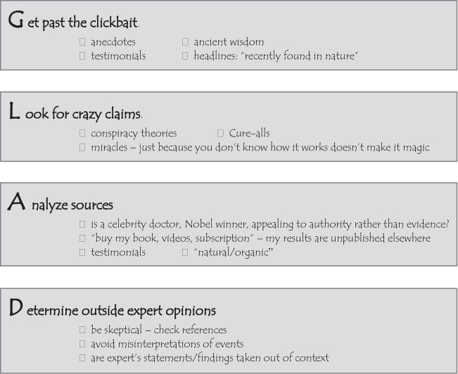
Finding the Faults Within Scientific Claims
Compound Interest 2015.

Slide 9
Strategies to Minimize Bias
Personal awareness
Acknowledgment of bias
Empathy
Advocacy
Education

Slide 10
Nursing’s Obligation to Impact Bias Within Health Policy Development or Reform
Take time for reflection
Know your political identity
Check your facts
  Tools and resources
Find an influential organization that can help
  Think tanks

Slide 11
Conclusion
Bias exists everywhere, including in health care.
Nurses have an obligation to get involved with change when they believe a healthcare practice or lack of practice creates an adverse situation for a group of individuals.
Advocating for change requires strong media literacy skills.

