Slide 1

Week 15 Assignment 2: Final Desk Guide and Video
Name
Course Title
Instructor
Date

Slide 2

Overview
Autism Spectrum Disorder
Trauma PTSD
Generalized Anxiety Disorder
Major Depressive Disorder
Substance Use
Pediatric anxiety and Depression
Major Depressive disorder (different from first tool)
Generalized Anxiety Disorder (different from first tool)
Suicide
Self Injurious Behavior
Dementia
Interpersonal Violence/ Domestic Violence/ Abuse

Slide 3
Autism Spectrum Disorder
Autism spectrum disorder (ASD) is a developmental disability marked by varying challenges.
ASD starts before three years and can last throughout an individual’s life.
Some children meet the developmental milestones to 18 to 24 months and stop meeting the desired developmental milestones.
A beneficial resource for individuals struggling with ASD include: https://www.cdc.gov/ncbddd/actearly/parents/index.html
No medical tests is available for diagnosing this condition.
The brief checklist of milestones (https://www.cdc.gov/ncbddd/actearly/pdf/FULL-LIST-CDC_LTSAE-Checklists2021_Eng_FNL2_508.pdf) is significant tool for parents in monitoring developmental milestone achievement (2023).
Parents can track the extent to which their children has achieved the social, language/communication, cognitive, and movement/physical milestones.

Slide 4
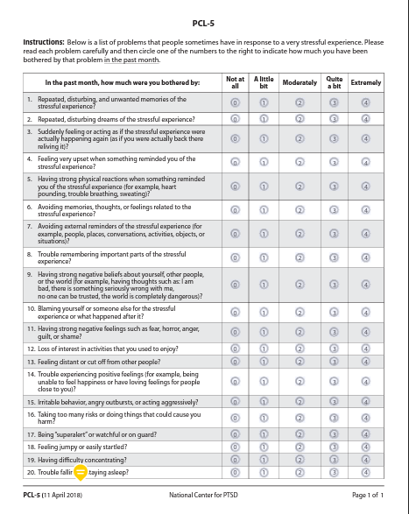
Trauma PTSD
Trauma PTSD is a disorder that develops following a scary, life-threatening, or dangerous event.
Symptoms include: re-experiencing, avoidance, arousal and reactivity symptoms.
Posttraumatic Stress Disorder Checklist (PCL-5) is used in conducting screening for trauma PTSD.
Results are obtained by adding the scoring of the 20 items.
One of the resources that can enhance the diagnosis and treatment of this condition is: https://www.colleaga.org/article/list-ptsd-organizations-and-resources

Slide 5
Generalized Anxiety Disorder
Generalized anxiety disorder (GAD) is a mental health disorder that is epitomized by frequent, intense, excessive and persistent worry about everyday situations.
Signs and symptoms include: hyperventilation, trembling, challenges concentrating, urge to avoid things that cause triggers among others.
One of the effective assessment tools for GAD include: the Generalized Anxiety Disorder 7-item (GAD-7).
Interpretation of the scoring:
Score 0-4: Minimal Anxiety
Score 5-9: Mild Anxiety
Score 10-14: Moderate Anxiety
Score greater than 15: Severe Anxiety

Slide 6
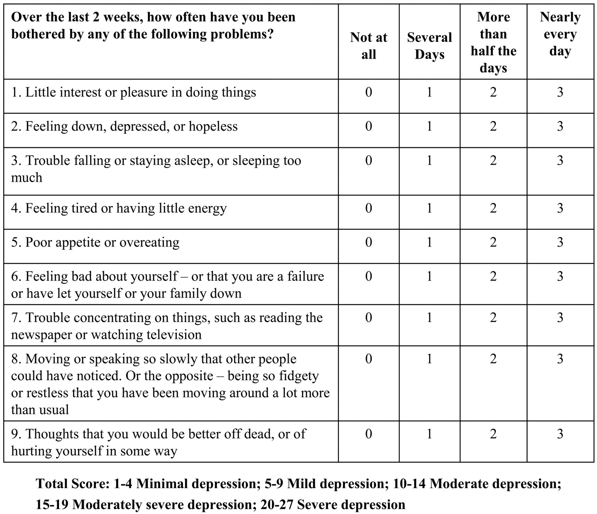
Major Depressive Disorder
Major Depressive Disorder (MDD) is a mood disorder that is marked by persistent feelings of sadness and loss of interest in pleasurable activities.
Symptoms of MDD include; feelings of sadness, loss of interest or pleasures, anxiety, sleeping challenges among others.
One of the screening tools for MDD is the Patient Health Questionnaire (PHQ -9).
A score of above 15 signals presence of MDD.
Individuals struggling with MDD can benefit from resources including: https://www.cdc.gov/reproductivehealth/depression/resources.htm

Slide 7
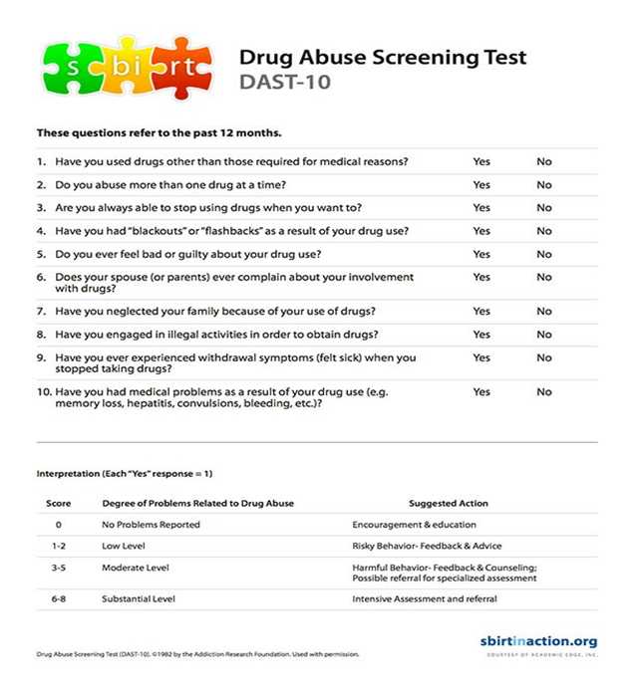
Substance Use
Substance use disorders are treatable mental health disorders affecting individual’s brain and behavior, and ability to control substances.
Drug overdose is a killer factor for individuals under the age of 45 years.
In screening for substance use, Drug Abuse Screen Test (DAST, also known as DAST-10), can be utilized.
Individuals struggling with substance use can benefit from a resource from: https://www.onlinemswprograms.com/resources/resources-addiction-and-recovery/

Slide 8

Pediatric Anxiety and Depression
Anxiety and depression are also diagnosed among the pediatric population.
Children with depression presents with depressed or irritable mood, mood swings, loss of energy, frequent sadness or crying, change in eating habits among others.
Children with anxiety tends to experience uncontrollable and extreme fear with certain triggers.
Children whose parents have depression are at a higher risk for developing it.
One of the effective resource for children struggling with anxiety and depression is: https://www.cdc.gov/childrensmentalhealth/depression.html
In screening for anxiety and depression among children, https://www.uspreventiveservicestaskforce.org/uspstf/draft-recommendation/screening-anxiety-children-adolescents and https://www.uspreventiveservicestaskforce.org/uspstf/draft-recommendation/screening-depression-suicide-risk-children-adolescents can be beneficial.

Slide 9
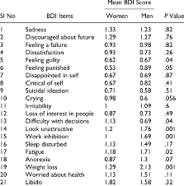
Major Depressive Disorder
The risk factors for major depressive disorder include:
serious chronic illness including cancer,
history of other mental health disorders
genetic predisposition of depression or bipolar disorder, and
experiencing traumatic or stressful event.
Individuals struggling with major depressive disorder can benefit from resources including: https://www.cdc.gov/reproductivehealth/depression/resources.htm
An effective screening tool for major depressive disorder is: Beck’s Depression Inventory (https://www.apa.org/pi/about/publications/caregivers/practice-settings/assessment/tools/beck-depression.

Slide 10
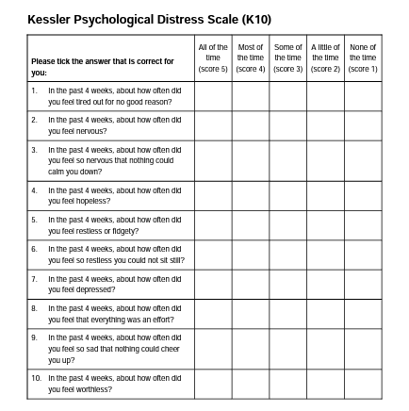
Generalized Anxiety Disorder
Some of the coping skills for individuals struggling with GAD include:
Keeping physically active,
Avoiding alcohol and recreational drugs,
Using stress management and recreational drugs, besides
Making sleep a priority.
Some of the GAD risk factors include:
Having a timid or negative temperament,
Genetic predisposition, and
Experiencing traumatic or negative experiences during childhood.
Individuals with this disorder can significantly benefit from resources from: https://www.everydayhealth.com/anxiety/guide/resources/
In screening for GAD, one of the effective screening and assessment tool is the: Kessler-10 (K-10) ().

Slide 11
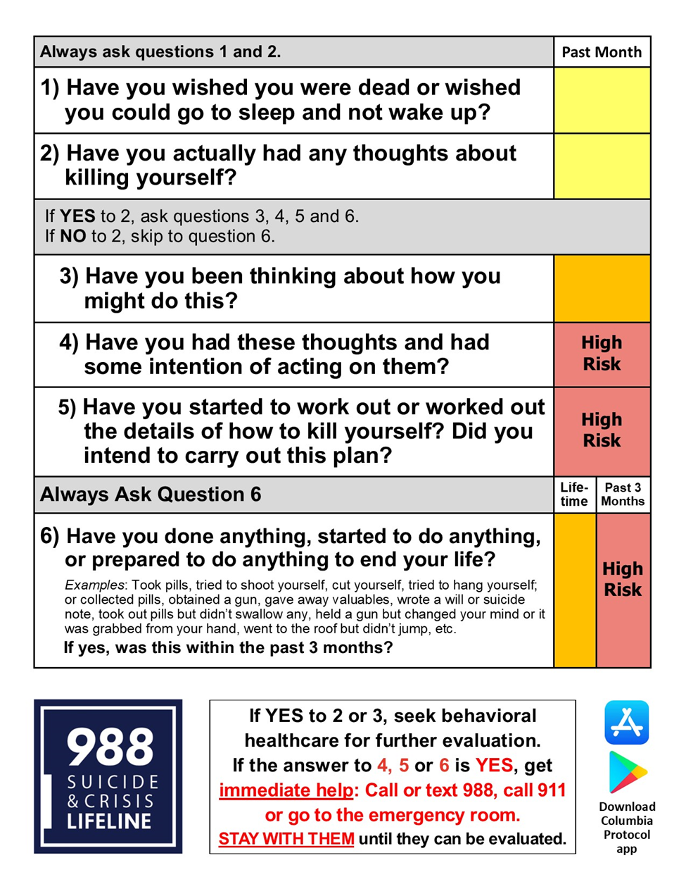
Suicide
Suicide assessment is significant as it facilitates the identification of individuals at risk and prevent the occurrence of suicide.
One of the effective suicide assessment and screening tool is the The Columbia-Suicide Severity Scale (C-SSRS).
The results of the screening informs the next course of action.
Individuals at an increased risk of suicide can benefit from: https://www.cdc.gov/suicide/resources/index.html

Slide 12

Self-Injurious Behavior
Self-Injurious Behavior (SIB) is a learned behavior representing a deliberate engagement in responses that cause harm to one’s self.
The risk factors linked to SIB include:
Having friends who self-injure,
Having a mental health issue such as depression,
Alcohol or drug use.
Assessment and screening for individuals at a risk of self-injury is significant in reducing the risk of self-injury.
One of the effective assessment tools for individuals with this condition is: the non-suicidal self-injury assessment tool (NSSI-AT) (www.selfinjury.bctr.cornell.edu).
One beneficial resource for these individuals is: https://counseling.humboldt.edu/self-harm-resources

Slide 13
Dementia
Dementia is the impaired ability to remember, think, or make decisions that interferes with doing everyday activities.
Dementia is caused by changes in the brain, including abnormal buildups of proteins.
Since dementia has no cure, some of the ways to avoid it include:
Physical activities,
Eating healthy,
Not smoking and drinking less alcohol, and
Being mentally and socially active.
One of the helpful screening tools for dementia include: general practitioner assessment of cognition (GPCOG) (http://gpcog.com.au/).
Individuals struggling with dementia can significantly benefit from the following resources including: https://www.alz.org/help-support/caregiving

Slide 14
Interpersonal Violence/Domestic Violence/Abuse
Interpersonal Violence/Domestic Violence/Abuse is a pattern of behavior used to establish power and control over another individual through fear and intimidation.
It takes several forms including:
Physical,
Emotional,
Sexual,
Economic, besides
Threats, stalking, isolation, and intimidation.
One of the screening tools for Interpersonal Violence/Domestic Violence/Abuse is: https://www.metroallianceforhealthyfamilies.org/Media/PDF/MAHFDomesticViolenceHARK-C.pdf
An effective resource for individual struggling with this form of abuse include: https://www.cdc.gov/violenceprevention/intimatepartnerviolence/index.html

Slide 15

References
CDC. (2023). What is a developmental milestone? Centers for Disease Control and Prevention. https://www.cdc.gov/ncbddd/actearly/milestones/index.html

Slide 16


