Slide 1

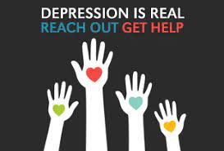
Proactive Health Communication Campaign: Depression In Adults
JIMMY BELLO
DNPU 705 HEALTH COMMUNICATION
DATE

Slide 2

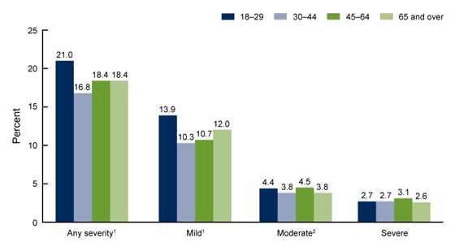
Overview
In 2019, 2.8 adults experienced severe depression symptoms, 4,2% moderate symptoms, and 11.5% experienced mild symptoms in the past 2 weeks.
Adults aged 18-29 adults accounting for 21% experienced the highest number of depressive symptoms, 18% were adults aged 45 -64 years and over 65 years had over 18.4%.
Women were more likely to experience depression symptoms compared to men
Non-Hispanic Asian adults were less likely to experience depression compared to non-Hispanic black and non-Hispanic white adults.
(CDC, 2020)

Slide 3
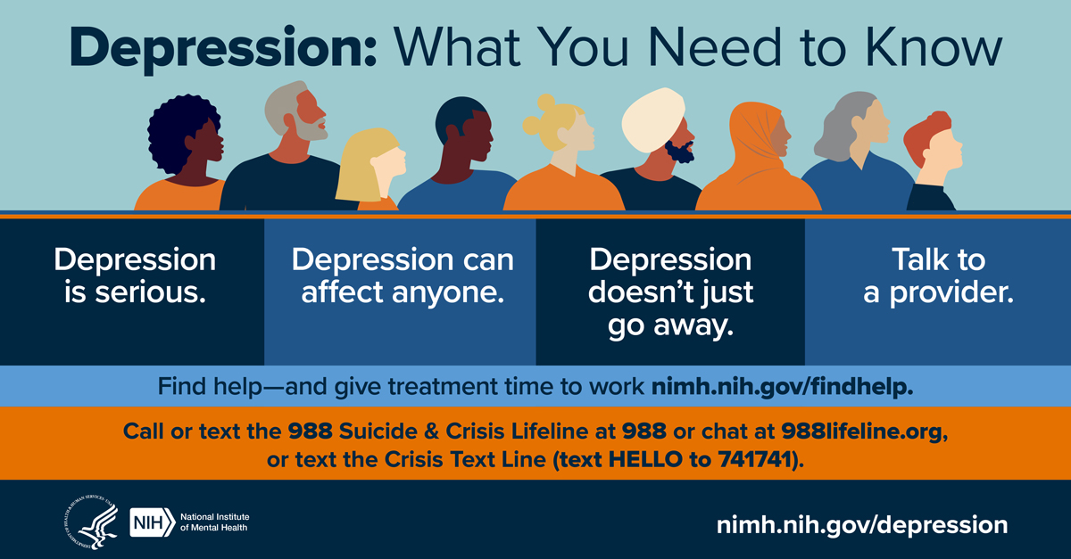
Health Communication Agenda
County And Subpopulation
Health Risk/Problem
The Rationale For Health Promotion
Theory Presentation
Multimedia Approaches
Resources
References
Questions

Slide 4
County and Subpopulation
Prince George County
Maryland State
United States
The rate of depression in adults ever diagnosed with depression was 12.5% in 2020 which is an increase from 12% in 2019.
(Prince George's County Health Department., n.d.).
In 2021, the rate of depression in Maryland is 16.6% of adults who reported being told to have a depressive disorder such as depression, major depression, and minor depression or dysthymia.
Adults aged 18 – 44 years had the highest depression rate of 20.2%
Depression rate was highest among multiracial accounting for 23.8% of the population.
(AHR.., n.d.).
In 2021, the rate of depression in the U.S. was 20.5% among adults who reported being told to have a depressive disorder such as depression, major depression, and minor depression or dysthymia.
The prevalence rate was highest in adults aged 18 – 44 years at 22.2% and among multiracial at 26.8%.
(AHR.., n.d.).

Slide 5

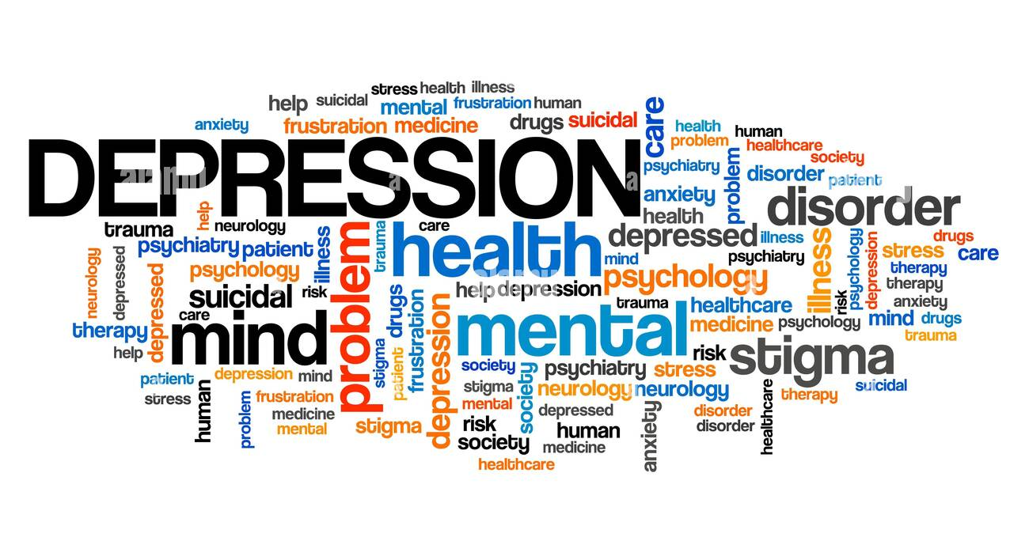
Health Risks/Problem
Depression is the leading cause of death and morbidity.
Prevalence and epidemiological data on depression are limited.
Comprehensive review has not been conducted with respect to burden and risk factors.
Determinants of depression include female gender, less education, stressful environments, financial problems, greater daily stress, and perceived low social status and chronic illnesses.
Depression is a major health concern causing:
    Functional impairment
    Increased medical costs
    Medical symptom burden.
    (Razzak et al., 2019)

Slide 6
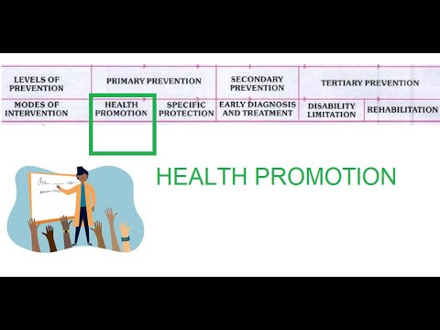
Rationale For Health Promotion in Depression
Management of depression involves close monitoring of risk factors and comprehensive interventions including effective antidepressant treatments and psychotherapy.
Health promotion and prevention of depression are feasible and effective across lifespans and settings.
Preventative measures in psychiatry is poorly utilized in addressing depression needs.
Novel interventions can address mental health needs across all populations.
(Singh et al., 2020)

Slide 7
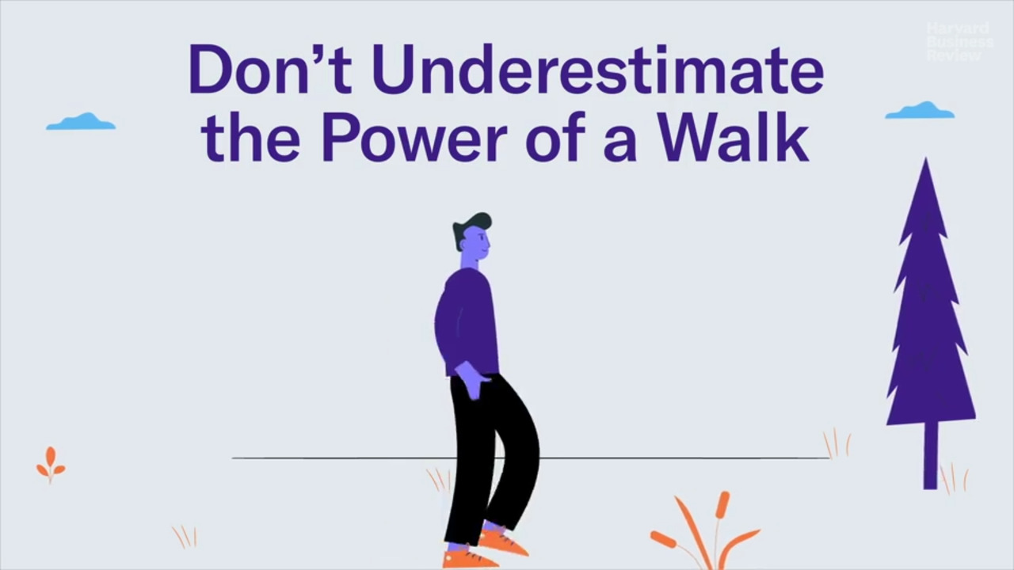
Use Of Exercise (Brisk Walking) In Reducing Depression
BENEFITS OF EXERCISES INCLUDE MODERATE 60 MINUTES OF BRISK WALKING
A short walk outdoors demonstrates positive changes in categorical affective responses in patients with major depression including;
  Activity.
  Fatigue.
  Passive control reduction of anger.
  Excitement.
Better clinical response, bridges the time for pharmacological effects and clinical outcomes due to improved treatment responses and cognitive behavioral therapies.
The affective response is influenced by the content of the exercise and is based on an interplay of cognitions and self-efficacy, worries, goals, or expectations
(Niedermeier et al., 2021)

Slide 8
Theory presentation
Pender’s Health Promotion model (HPM)
Overview
Designed by Nola J. Pender.
First appeared in 1982 and revised in 1996.
Purpose of the Model
To assist nurses to understand determinants of healthy behaviors for behavioral counseling to promote healthy lifestyles.
Application;
Patients’ feelings toward brisk walking - Brief introduction aim or objectives of the exercise in depression.
Perceived sensitivity – Emphasize walking.
Perceived benefits – Reduction of depression
Perceived barriers – Lack of walking
Perceived self-efficacy – Presence of a companion per session such as a dog walk
Commitment to planning – Distribution of pamphlets and handouts.
Interpersonal & situational influences – Use of alternative means such as vehicles.
Competitive preferences & desires – invite companions and recommend resources such as parks.
(Rouholamini et al., 2020).

Slide 9
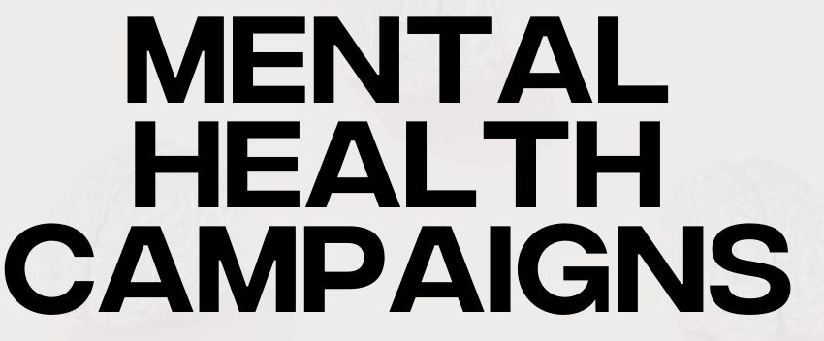
Multimedia Approaches
Use of social media platforms for mass communication to increase awareness of mental health such as Facebook, Twitter, and Instagram posts and videos, and most convenient to young adults.
Public service announcement (PSA) intervention used to target the general population with smaller health messages such as focus groups including social marketing campaigns.
Interactive multimedia computer program (IMCP) tailored health messages for targeted to individualized levels depending on the level of depression and agenda.
Printed media such as leaflets, brochures, posters, billboards, books, and articles.
Television such as movies, films, and videos is the most viable.
Media combination of more than one media is associated with greater success in health promotion programs

Slide 10


Resources
Anxiety and Depression Association of America (ADAA) https://adaa.org/
National Alliance on Mental Health (NAMI) & NAMI Helpline http://www.nami.org/ (https://988lifeline.org/)
National Institute of Mental health (NIMH) https://www.nimh.nih.gov/
Association of Behavioral and Cognitive Therapies (ABCT) https://www.abct.org/
Mass General MADI Resource Center https://www.massgeneral.org/psychiatry/about/patient-education
Mental Health America https://mhanational.org/

Slide 11
References
America's health rankings. AHR. (n.d.). America’s Health Rankings. https://www.americashealthrankings.org/explore/annual/measure/Depression_a/state/MD
Centers for Disease Control and Prevention (CDC). (2020, September 23). Products - data briefs - number 379 - September 2020. Centers for Disease Control and Prevention. https://www.cdc.gov/nchs/products/databriefs/db379.htm
Prince George's County Health Department. (n.d.). Prince George's County health department: Indicators: Adults ever diagnosed with depression: County: Prince George's. https://embed-pgchd.thehcn.net/indicators/index/view?indicatorId=2867&localeId=1260
Niedermeier, M., Ledochowski, L., Leitner, H., Zingerle, H., & Kopp, M. (2021). Acute effects of a single bout of walking on affective responses in patients with major depressive disorder. International journal of environmental research and public health, 18(4), 1524. https://doi.org/10.3390%2Fijerph18041524
Razzak, H. A., Harbi, A., & Ahli, S. (2019). Depression: prevalence and associated risk factors in the United Arab Emirates. Oman medical journal, 34(4), 274. https://doi.org/10.5001%2Fomj.2019.56
Singh, V., Kumar, A., & Gupta, S. (2022). Mental Health Prevention and Promotion—A Narrative Review. Frontiers in Psychiatry, 13. https://doi.org/10.3389%2Ffpsyt.2022.898009
Nursing Theory (n.d). Nola Pender - Nursing Theorist. https://nursing-theory.org/nursing-theorists/Nola-Pender.php
Rouholamini, S., Gheibizadeh, M., Maraghi, E., & Jahanshahi, A. (2020). The effects of a training program based on the health promotion model on physical activity in women with type 2 diabetes: a randomized controlled clinical trial. Iranian journal of nursing and midwifery research, 25(3), 224. https://doi.org/10.4103%2Fijnmr.IJNMR_97_19

