Slide 1
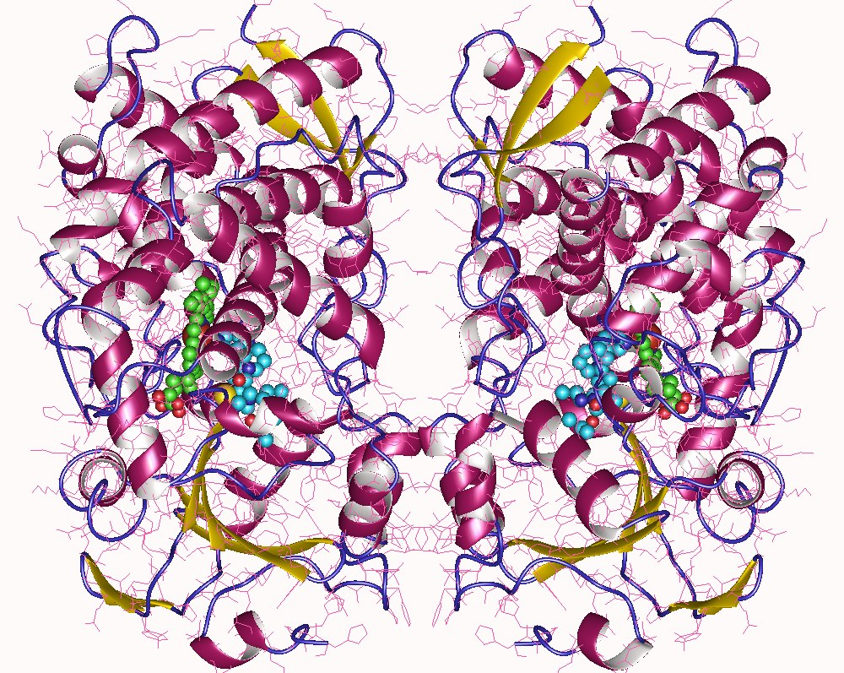
CYP3A4 Enzyme
Student’s Name
Institution
Course Title
Professor’s Name
Date

Slide 2
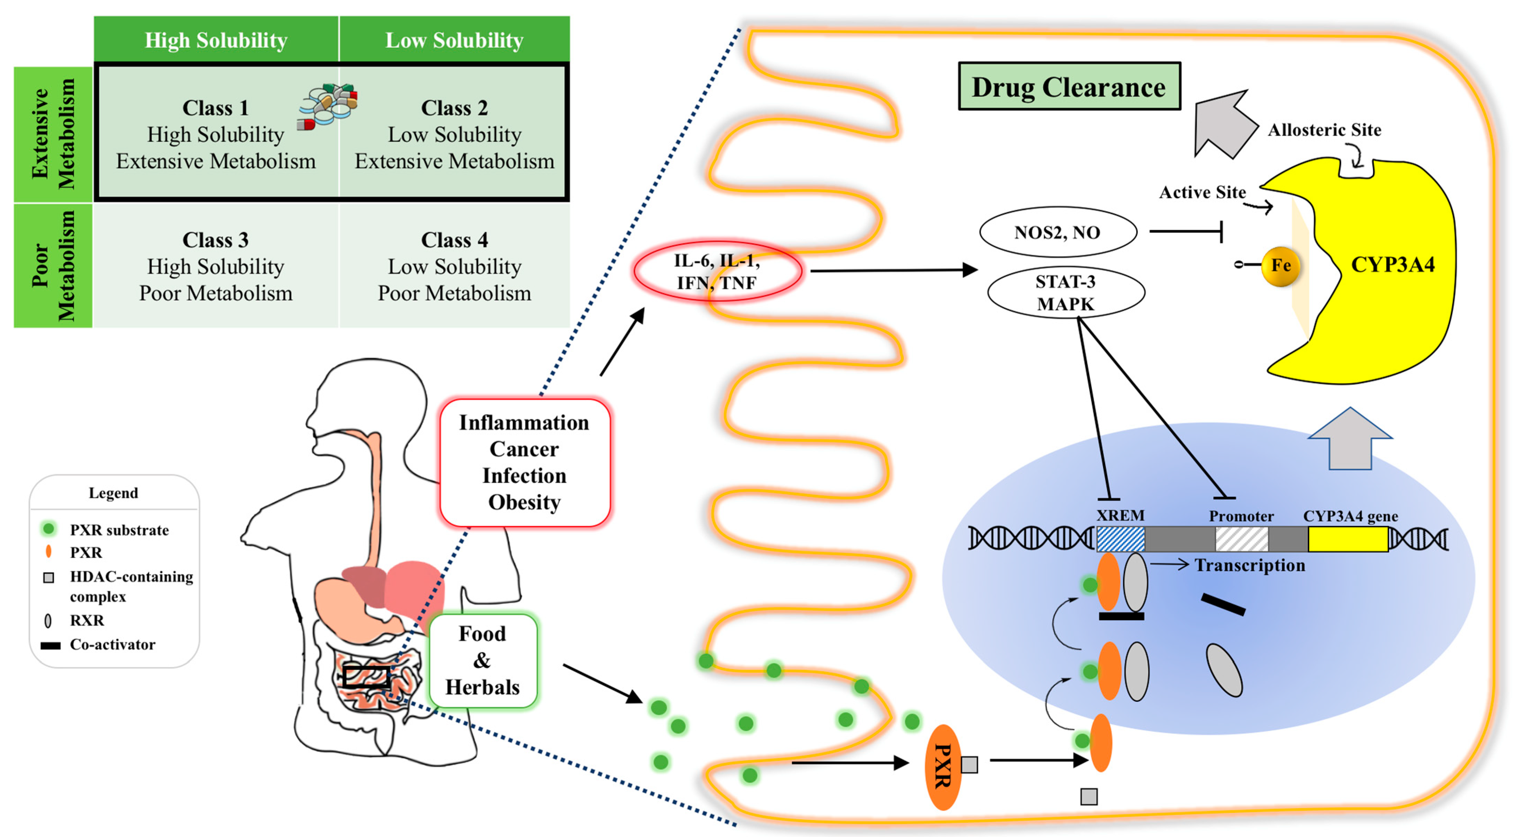
Selected Enzyme
The selected enzyme for this discussion is cytochrome P450 commonly abbreviated as CYP3A4.
It plays a crucial role in the metabolism process of drugs and foreign compounds.
Usually located in the intestines and liver.
Responsible for metabolizing drugs, hormones and steroids.
Specific medications and substrates such as erythromycin, St. John's Wort, and grapefruit juice, can inhibit the functionality of the CYP3A4 enzyme.
It is crucial to understand the medication restrictions for CYP3A4 to avoid high dosage or combination of specific drugs.
Notes:
The enzyme selected for this assignment is cytochrome P450 3A4, commonly abbreviated as CYP3A4. This enzyme plays a crucial role in the body, mainly found in the intestine and the body. It is one of the most crucial elements that enable the human body to metabolize foreign compounds and other drugs (Guttman & Kerem, 2022). Also, it is a member of the cytochrome P450 enzymes responsible for metabolizing drugs, steroids, hormones and toxins. The ability of CYP3A4 to metabolize a wide range of drugs makes it a crucial enzyme in commonly prescribed medications. Some medications that inhibit the functionality of the CYP3A4 enzyme include specific antibiotics such as erythromycin, St. John’s Wort and grapefruit juice (Sevrioukova & Poulos, 2013). Some vital medication restrictions related to this enzyme include avoiding specific high dosages of specified drugs and avoiding a combination of certain drugs since they bring forth a risk of advanced reactions.

Slide 3
Importance
Responsible for the metabolism of drugs
In the absence of the enzyme, medications may not be effectively metabolized leading to ineffectiveness or toxicity.
Variations in the enzyme is used by medical professionals to determine interactions between supplements and medications.
CYP3A4 is used for guidance in medication dosage and usage among individuals.
Notes:
The CYP 3A4 enzyme is vital in several ways. First, it is responsible for the metabolism of medications. Without this enzyme, medications would not be adequately metabolized, leading to ineffectiveness or toxicity (Guttman et al., 2019). Also, medical professionals utilize enzyme variation to determine whether supplements or herbs interact with certain medications. Since the enzyme is responsible for the metabolism of herbs and supplements like John’s Wort, grapefruit juice and others, when taken together with medications, the supplements have the potential that is metabolized by CYP 3A4. They may inhibit the enzyme's ability to metabolize the medications leading to potential medical 3 complications (Guttman et al., 2019). Next, CYP 3A4 is used for medication guidance regarding dosage and selection among individuals.

Slide 4
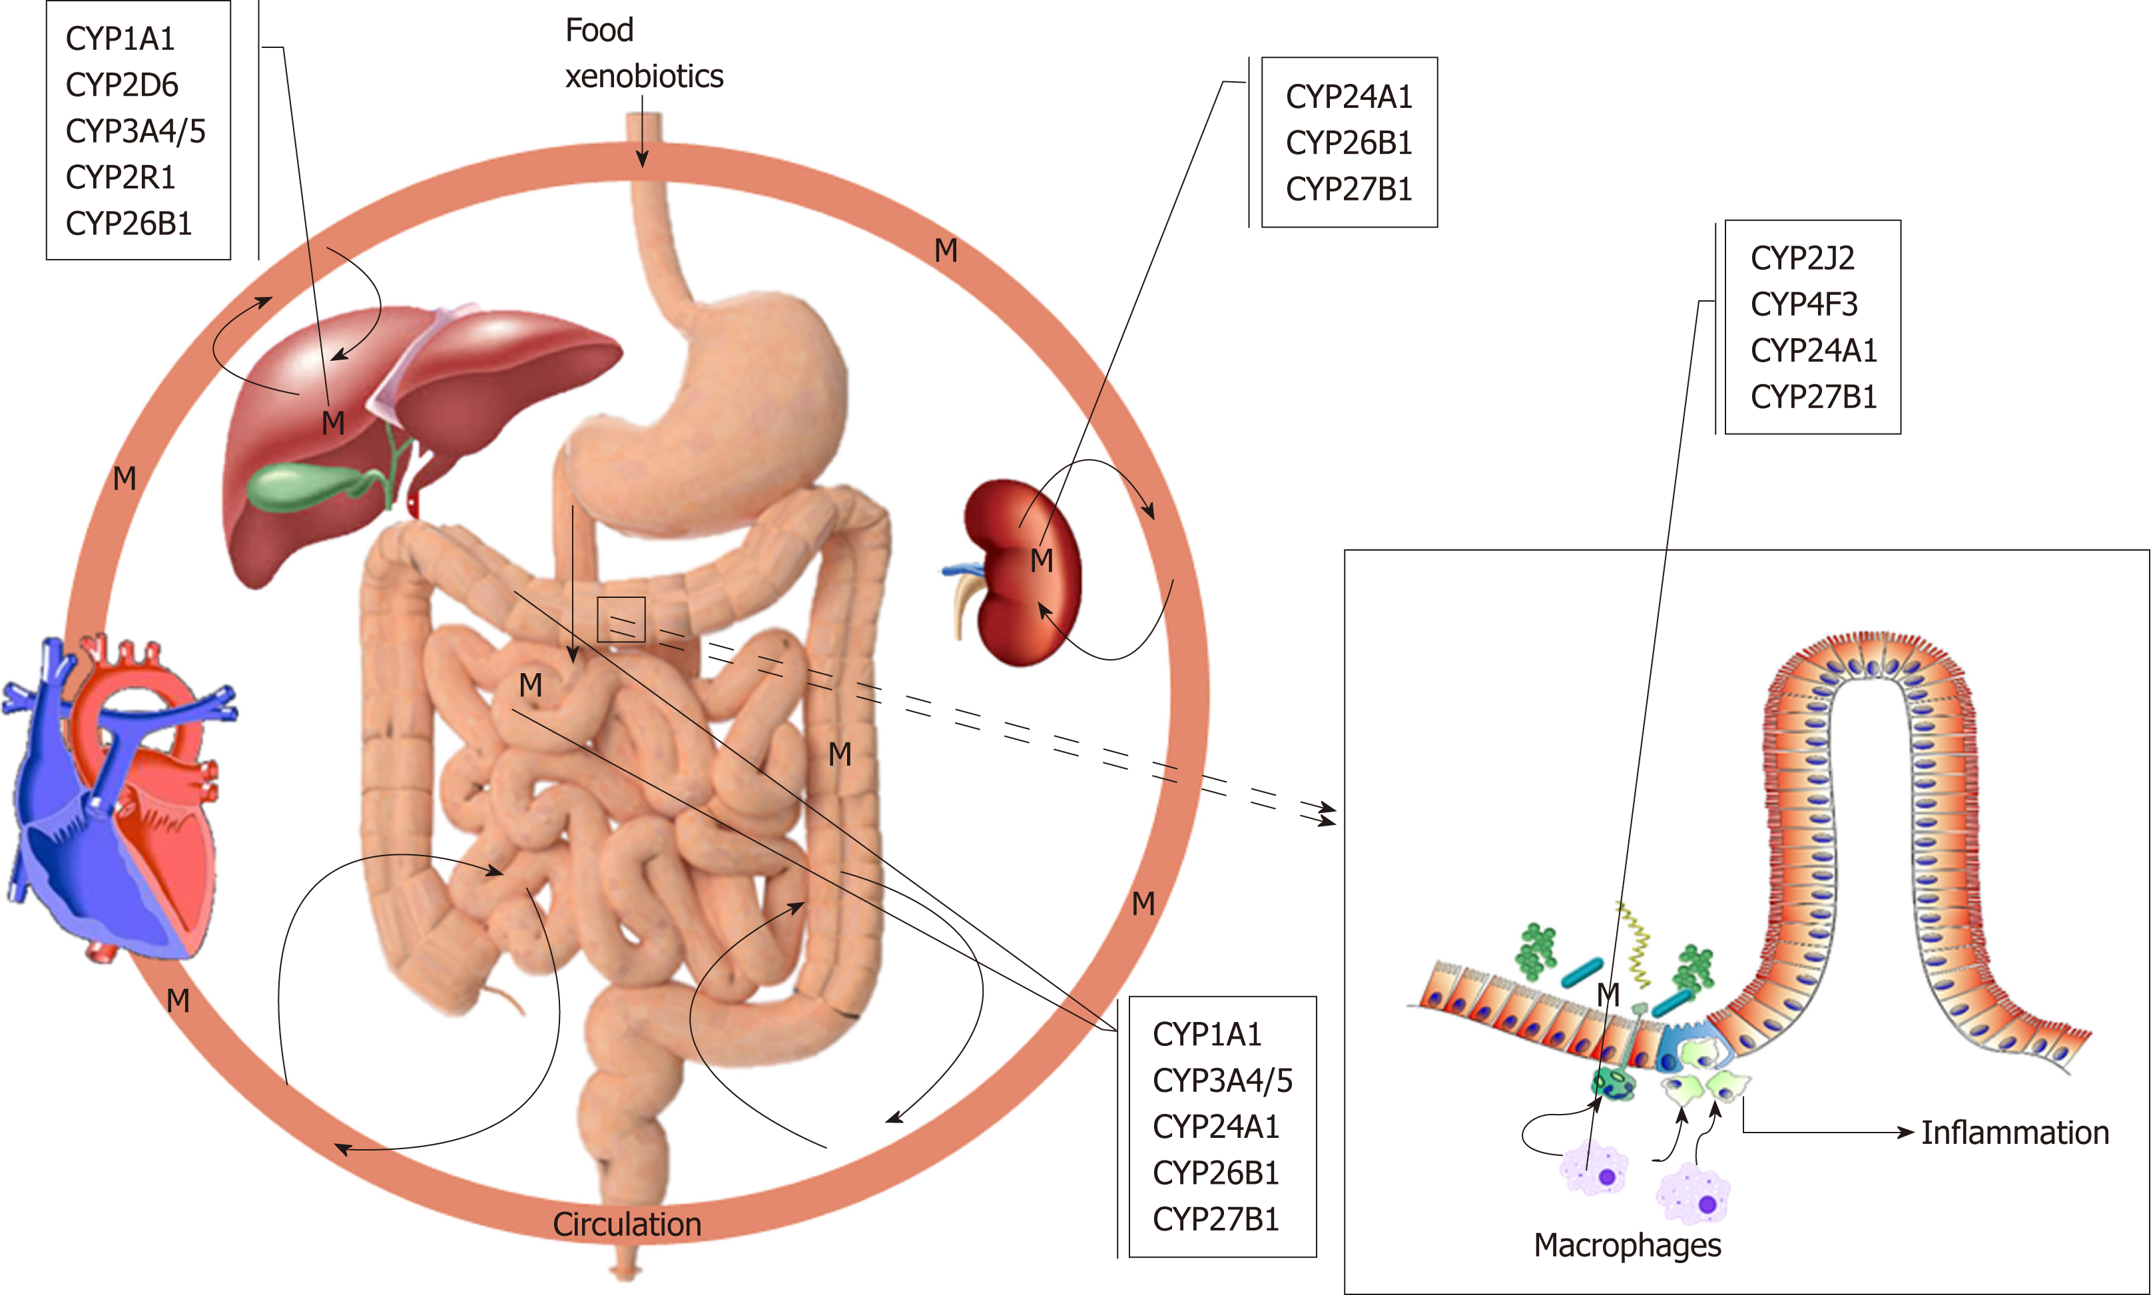
Its Role in the Human Body
Plays a primary role in the metabolism of drugs such as statins anti-depressants and immunosuppressant's.
converts drugs into active forms that can be excreted quickly from the body through the process of biotransformation.
Metabolizes other drugs that are toxic to the body, particularly when an individual has been prescribed a drug with a narrow therapeutic window.
Reduces the risk of toxicity of drugs by metabolizing them.
Involved in the metabolism of other bodily substances such as nutrients and hormones, including testosterone, vitamin D, and estrogen.
Notes:
The primary role that the CYP 3A4 enzyme plays in the human body is carrying out the metabolism of drugs that are metabolized in the body, such as statins, anti-depressants and immunosuppressants. One of the roles of the CYP 3A4 enzyme is converting drugs into active forms so they can be excreted quickly from the body through the process of biotransformation (Pérez-del Palacio et al., 2017). This process is critical for the functioning of many drugs. The other crucial function of the enzyme is metabolizing other drugs that are toxic to the body (Pérez-del Palacio et al., 2017). Specifically, this role is essential when an individual has been prescribed a drug with a narrow therapeutic window, meaning there is a minute difference between the toxic and safe dose. When CYP 3A4 metabolizes the drugs, it reduces the risk of toxicity of the drug. Next, the enzyme is also engaged in metabolising other bodily substances, such as nutrients and hormones. It is involved in the metabolism of testosterone, vitamin D and oestrogen.

Slide 5
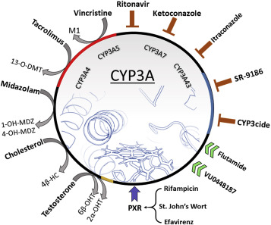
Common Medications that Inhibit the Enzyme
Azole antifungals like ketoconazole and itraconazole
Protease inhibitors like ritonavir and indinavir
Calcium channel blockers like verapamil and diltiazem
specific antidepressants like nefazodone and fluoxetine
Specific anti-anxiety medications such as buspirone and alprazolam
some herbs and dietary supplements like St. John’s Wort
Notes:
Some common medications and substrates that inhibit CYP 3A4 include calcium channel blockers. These drugs are used to treat high blood pressure and other cardiovascular conditions (Center for Drug Evaluation and Research, 2019). They can either inhibit or increase the levels of drugs metabolized by the enzyme. Examples may include verapamil, amlodipine and diltiazem. Other antifungals that inhibit the enzyme are ketoconazole and voriconazole; anti-depressants like fluoxetine, fluvoxamine and paroxetine; and some antibiotics like ritonavir (Center for Drug Evaluation and Research, 2019). Also, some herbs and dietary supplements like St. John’s Wort inhibit the enzyme and increase the levels of the drugs being metabolized by the drug.

Slide 6
Important medication Restrictions
Inhabitants such anti-depressants and antifungals may lead to increased potential side effects.
Certain herbal supplements and anti-seizure drugs can increase the activity of CYP 3A4 leading to decreased effectiveness of certain drugs.
Substrates such as calcium channel blockers, immunosuppressant's, and inhibitors or inducers.
The interaction between medications and enzymes like CYP 3A4 should be taken into consideration when prescribing or using drugs.
Notes:
Some of the critical restrictions related to the enzyme include inhibitors. Specific medications such as antifungals and anti-depressants inhibit CYP 3A4 and cause slow metabolism of other drugs. This can increase the level of specific medications in the body, increasing the possibility of side effects and toxicity in the body. Next, inducers such as some herbal supplements and anti-seizure drugs can increase the activity of CYP 3A4, catalyzing the metabolism of other drugs (Hakkola et al., 2020). It can result in lower levels of specific drugs in the body resulting in their ineffectiveness. Lastly, in substrates like calcium channel blockers, immunosuppressants and an inhibitor or inducers, the metabolism of the substrate may be affected. This may cause changes in the effectiveness of the drugs.

Slide 7
References
Center for Drug Evaluation and Research. (2019). Table of Substrates, Inhibitors and Inducers. U.S. Food and Drug Administration. https://www.fda.gov/drugs/druginteractions-labeling/drug-development-and-drug-interactions-table-substratesinhibitors-and-inducers
Guttman, Y., & Kerem, Z. (2022). Dietary Inhibitors of CYP3A4 Are Revealed Using Virtual Screening by Using a New Deep-Learning Classifier. Journal of Agricultural and Food Chemistry, 70(8), 2752–2761. https://doi.org/10.1021/acs.jafc.2c00237
Guttman, Y., Nudel, A., & Kerem, Z. (2019). Polymorphism in Cytochrome P450 3A4 Is Ethnicity Related. Frontiers in Genetics, 10. https://doi.org/10.3389/fgene.2019.00224
Hakkola, J., Hukkanen, J., Turpeinen, M., & Pelkonen, O. (2020). Inhibition and induction of CYP enzymes in humans: an update. Archives of Toxicology, 94(11), 3671–3722. https://doi.org/10.1007/s00204-020-02936-7
Pérez-del Palacio, J., Díaz, C., Vergara, N., Algieri, F., Rodríguez-Nogales, A., de Pedro, N., Rodríguez-Cabezas, M. E., Genilloud, O., Gálvez, J., & Vicente, F. (2017). Exploring the Role of CYP3A4 Mediated Drug Metabolism in the Pharmacological Modulation of Nitric Oxide Production. Frontiers in Pharmacology, 8, 202. https://doi.org/10.3389/fphar.2017.00202
Sevrioukova, I. F., & Poulos, T. L. (2013). Understanding the mechanism of cytochrome P450 3A4: recent advances and remaining problems. Dalton Trans., 42(9), 3116– 3126. https://doi.org/10.1039/c2dt31833d

