Slide 1
Environmental Factor and Health Promotion
Student’s name
Institutional affiliation
Professor’s name
Course title
Due date

Slide 2
Introduction
Environmental risks harm the health and growth of infants from the time they are born all through their stages as children and adolescents until they become adults.
Therefore, lowering the levels of environmental risks could help prevent millions of childhood deaths (WHO, 2023). The deaths arise from breathing problems, diarrhea, disturbance of the normal functioning of the infants, malaria, and also accidental harm.
The environment decides the future of the infants. Being exposed to environmental hazards earlier affects their health as adults because of the interference of prenatal programming and early development.
Unfavorable environmental circumstances and pollution pose the main causes of infant mortality, sicknesses, and disability, especially in developing nations (WHO, 2023).

Slide 3
Environmental health factor Air pollution
The pollution of the inside and outside surroundings by chemical, physical, and natural contaminants alter the quality of air.
The main causes of air pollution are vehicles, factories, in-house burning facilities, and fires that originate from forests.
The main pollutants that affect public health including children are particulate matter, nitrogen dioxide, carbon monoxide, ozone, and sulfur dioxide.

Slide 4
Environmental health factor
According to WHO, most of the population in the world takes in the air that goes beyond the WHO guideline limits and has increased rates of pollutants.
Children are among the vulnerable to pollution that is at higher risk of poor-quality air (UNEP, 2018)..
Notes:
The regions that suffer most from increased contamination are the low and middle-income nations (WHO, 2023).
Infants are prone to increased pollution rates especially when they walk to school and while playing on the field. This shows that the impact on infants is higher than on adults

Slide 5
Factors for higher risks of air pollution for fetuses, newborns, and young children.
Children are still in their growth stages of life and therefore early exposure leads to long-term health issues (UNEP, 2018).
Height is another factor, particularly in urban areas. Children have shorter heights compared to grownups and this shows that they are nearer to the ground and also the exhaust pipes of cars.
Also, children inhale air faster (UNEP, 2018).
Notes:
1. Being exposed to air pollution at their earlier stages interferes with lung and brain development, and also causes higher risks of health conditions for instance asthma.
3. This implies that they breathe in more air compared to their body weights.

Slide 6
Effects of air pollution on children.
Air pollution causes breathing problems and affects the immune system. Exposure to particulate matter affects the growth of lungs and respiratory health in many ways that continue as affects them as they grow (Johnson et al., 2021).
Air pollution also causes asthma and pneumonia. The immune system is also gets affected by air pollution in several ways (Johnson et al., 2021)..
Notes:
Exposure to particulate matter causes interference with the processes of alveolarization, lung operations, and pulmonary immune differentiation and these lead to severe health consequences.
Exposure to numerous contaminants leads to high risks of wheezing and asthma that persists in their childhood.
Particulate matter exposure of the fetus relocates the normal positioning of white blood cells which acts as the infant's immune response in umbilical cord blood. This in turn causes medical issues

Slide 7
Effects of air pollution on children.
Low birth weight is also an outcome of air pollution. Birth is an essential measure of consequential health problems (Veras et al., 2022).
Maternal subjection to air pollution affects the development of the fetus (Veras et al., 2022).
Notes:
This implies that babies with low birth weight are vulnerable to hypertension, coronary heart illness, and diabetes that depends not on insulin.
For instance, pollutants such as nitrogen oxide affect the femur length of the fetus, and together with particulate matter, they cause a reduced head circumference of the fetus.

Slide 8
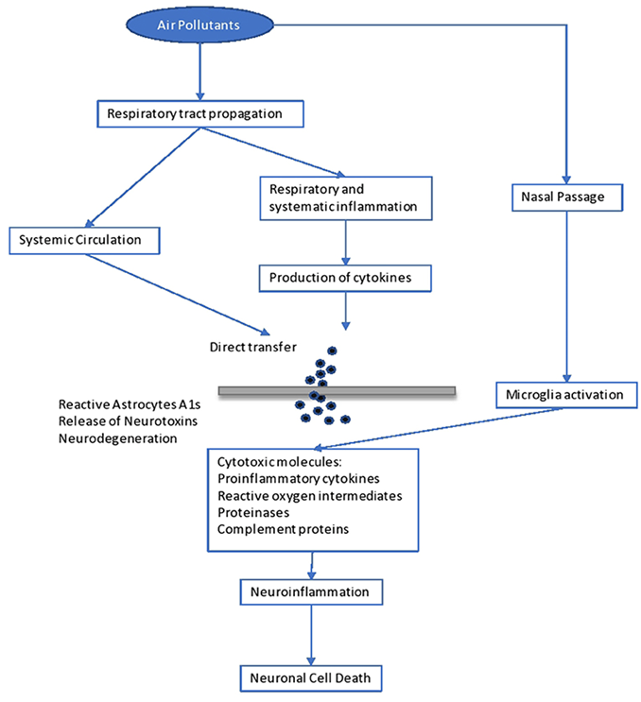
Disease transmission

Slide 9
Health and safety promotion Lowering the levels of exposure to household air pollution
This involves using clean fuels, improving the ventilations at home, and making use of effective cookstoves as required (Carlsten et al., 2020). While at home, cleaner fuels that include biogas, electricity or solar cookers, and liquid petroleum can be used instead of biomass fuels that include wool and animal dung.
Cooking areas and that places that have lighted mosquito coils should be well-ventilated. Cross ventilation can be adopted by ensuring doors and windows are closed, and also making use of chimneys (Carlsten et al., 2020).
Traditional cookstoves that are created using mud or stones should be replaced with efficient cookstoves created by engineering designs or by using a fan to enhance ignition (Carlsten et al., 2020).
Notes:
This helps lower the risks of respiratory illness in infants 5 years and below and also lowers the number of hospital stays and deaths of the affected infants.
This intervention is associated with lowered interference of lung operations and development of the infants together with the impacts of the expectant mothers.
This helps lower emission levels by 90%. Caregivers should try to advise parents on how to adhere to using efficient stoves to ensure they adopt them and understand the impact of traditional cookstoves.

Slide 10
Health and safety promotion Staying informed and disseminating knowledge
Caregivers have an essential responsibility in recognizing the threats to human health for them to prevent the resultant illnesses (WHO, 2018).
The caregivers can also research the impact of air pollution on the health of infants and publish the outcome of the research (WHO, 2018).
Notes:
1. The caregivers can recognize causative factors related to air pollution by interviewing the mothers of the infants or expectant mothers concerning their home environment.
2. They can publish the causes, means, and impact of environmental exposure on infants together with possible treatment, control, and how to reduce pollutants.

Slide 11
Health and safety promotion Use travel routes that lessen road air pollution exposure.
This can be done by ensuring that children do not pass through roads with main intersections and heavy traffic together with those that have increased emissions on the sides (Carlsten et al., 2020).
Roads that have open spaces should be used often since they increase the diffusion of air contaminants.
Making use of the updated information about the local air quality to direct the paths and movement schedules (Carlsten et al., 2020).
Notes:
There is a higher concentration of particulate matter on road intersections and heavily trafficked roads compared to roads with no traffics.
Areas with open spaces have reduced concentrations of air pollutants.
This can be obtained from mobile phone apps, websites, and news reports.

Slide 12
Community Resources
1. American Lung Association.
Dedicated to saving lives by improving the health of the lungs and preventing lung disease.
Contact information
tel:1-800-586-4872
2. Nationwide Children’s Hospital, 700 Children Drive
Dedicated to addressing the social determinants of health, and developing payment models to better serve unique populations of children.
Contact Information
Columbus, OH 43205

Slide 13
References
Carlsten, C., Salvi, S., Wong, G. W., & Chung, K. F. (2020). Personal strategies to minimise effects of air pollution on respiratory health: advice for providers, patients and the public. European Respiratory Journal, 55(6).
Johnson, N. M., Hoffmann, A. R., Behlen, J. C., Lau, C., Pendleton, D., Harvey, N., ... & Zhang, R. (2021). Air pollution and children’s health—A review of adverse effects associated with prenatal exposure from fine to ultrafine particulate matter. Environmental health and preventive medicine, 26(1), 1-29.
UNEP. (2018). Young and Old, Air Pollution Affects the Most Vulnerable.
Veras, M., Waked, D., & Saldiva, P. (2022). Safe in the womb? Effects of air pollution to the unborn child and neonates. Jornal de Pediatria, 98, 27-31.
WHO. (2023). Children's Environmental Health.
World Health Organization. (2018). Air pollution and child health: prescribing clean air: summary (No. WHO/CED/PHE/18.01). World Health Organization.

