Slide 1

Healthy People 2030
Population: Individuals with Addiction
Regis College: Young School of Nursing
NU 713 - Epidemiology/Biostatistics
Kimberly Hakaj BSN, RN

Slide 2
Assignment Objectives
At the end of this presentation, the participant will be able to:
Understand the goal for individuals battling addiction
Explain the importance to epidemiology
Identify the needs within different levels of prevention to aid those with addiction

Slide 3
Healthy People 2030 Objective
Reduce drug and alcohol addiction
Increase treatment options
Increase admissions to inpatient treatment
Improve referrals after use of emergent services
U.S. Department of Health and Human Services, 2024
Notes:
Healthy People 2030 includes objectives aimed at reducing substance use and increasing access to treatment.
Progress has been mixed, with some objectives met or on track while others lag behind, particularly concerning opioid overdoses.

Slide 4
Importance to Epidemiology
Set national health objective to improve health and wellbeing
Identifies trends and disparities
Addresses social determinants
Influence public health policies
Create supportive environment
Establish benchmarks for progress
U.S. Department of Health and Human Services, 2024
Notes:
Set national health objective to improve health and wellbeing
Identifies trends and disparities used to set specific measurable goals for prevention, treatment, and recovery
Addresses social determinants including socioeconomic status, education, and access to care
Influence public health policies toward treatment and prevention
Create supportive environment through collaborative efforts
Establish benchmarks for progress that can be used by healthcare professionals to track improvements and outcomes

Slide 5
Populations Affected
Addiction does not discriminate!
Disabilities and Medical History
Educational level and socioeconomic status
Family history / Genetics
Mental Health Disorders
Exposure / Environment
(Ellis et al., 2024, United States Department of Health & Human Services, 2023)
Notes:
Addiction affects various demographic groups; however, young adults (18-25) show notably high rates of substance use disorders.​
Geographic patterns indicate higher rates in urban areas and regions with socioeconomic challenges.​
Monthly data could reveal trends, such as increased substance use during specific seasons or holidays.​
Urban neighborhoods with limited access to healthcare and social services exhibit higher addiction rates.​
Vulnerable populations, including individuals experiencing homelessness or those with co-occurring mental health disorders, face heightened risks.​
Certain demographics, like young adults, males, and marginalized ethnic groups, often exhibit higher addiction rates.​
Understanding these patterns can lead to targeted interventions and research into causal factors, such as social determinants of health.

Slide 6
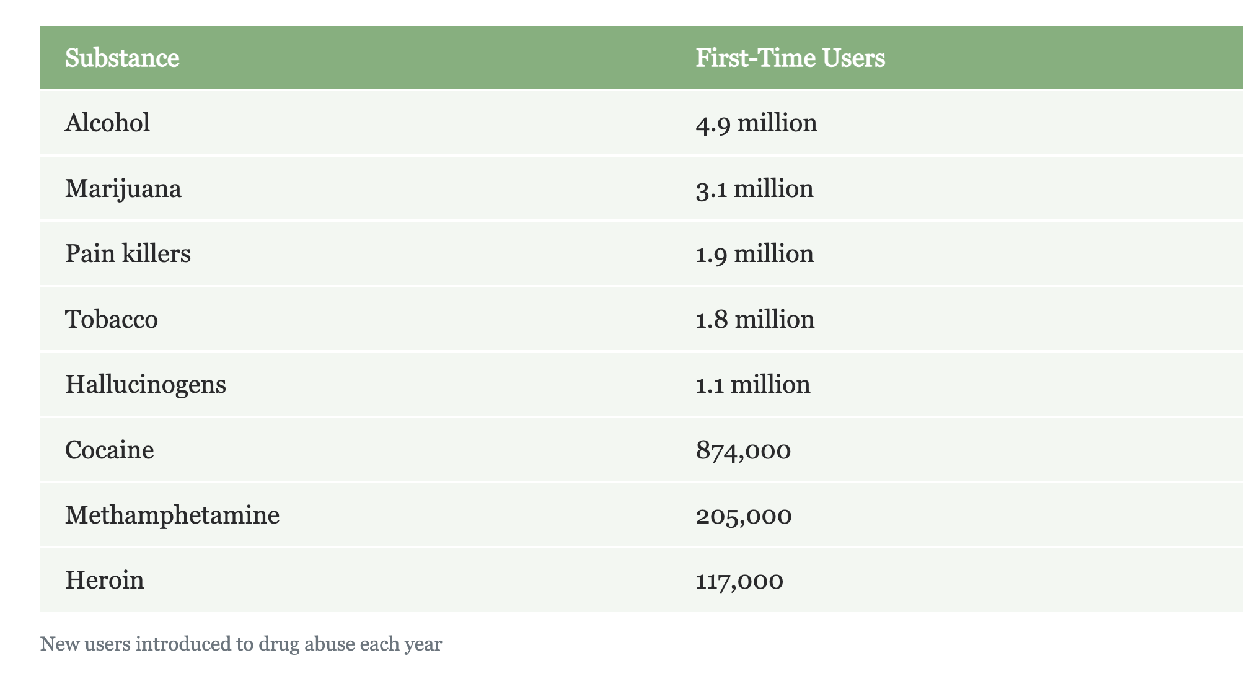
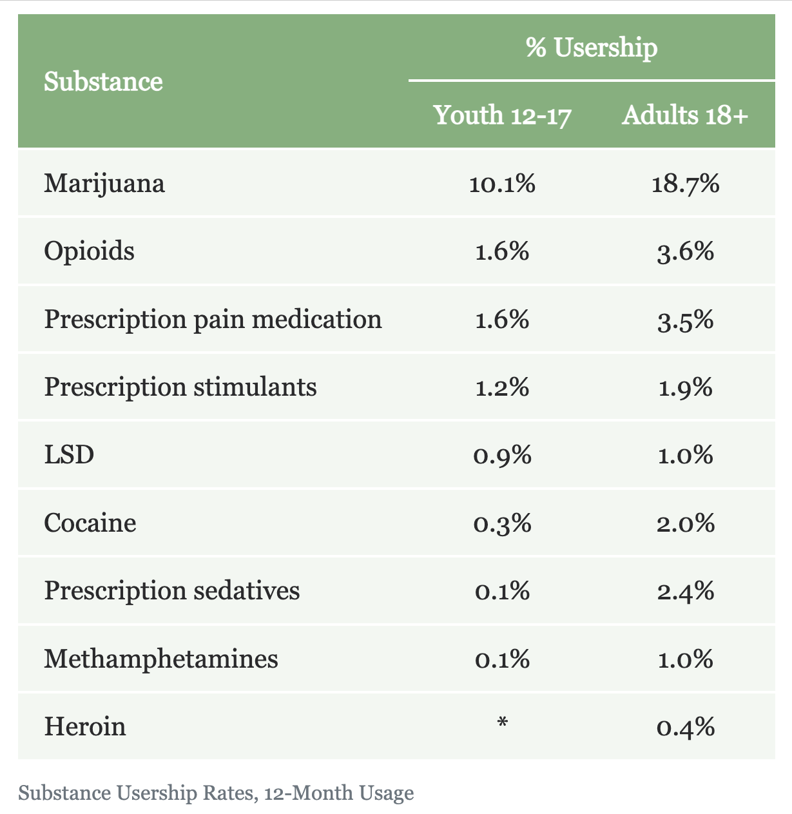
Drug Abuse Statistics
(National Center for Drug Abuse Statistics, 2024)

Slide 7
Limitations and Gaps​
Underreporting due to stigma
Data collection does not encompass marginalized communities
Lack granularity
Notes:
There may be underreporting due to stigma associated with addiction.​
Data collection may not fully encompass marginalized communities, leading to potential gaps in understanding the true extent of the issue.​
Temporal data may lack granularity, missing seasonal variations in substance use patterns.

Slide 8
Three Levels of Prevention
    Primary Secondary Tertiary
Before evidence of disease | After disease has begun, before symptomatic | After disease is established
Education | Early detection and intervention | Educate on safe practice
Increase protective factors | Decrease stigmatization | Offer continued treatment options
Reduce risk factors | Increase treatment options post detection | Supplemental measures; medications, medical care, nutrition and support
(Latimore et al., 2023)​
Notes:
Primary Prevention:
Focuses on preventing initial substance use through education and community programs.
Secondary Prevention:
Involves early identification and intervention for at-risk individuals to prevent the progression of addiction.
Tertiary Prevention:
Targets individuals with established substance use disorders, emphasizing treatment and recovery support services.

Slide 9
1979 - 2021 Case Study:
46 studies combined : Increased Substance Use
  Mental health
  Black v. White
  Limited access
  Culturally accepted
  Lower education & socioeconomic status
(Tang et al., 2024)
Notes:
40 million Americans reported + substance use (> 12 years old)
26yo and over; higher use with
- increase mental health disorders
- within Black communities over White
- limited access to health care / treatment
- cultural norms
- lower education & socioeconomic status
Limitations:
- restricted ethnic populations
- sample size
- males v females
- not all took into account mental health tx
- not all took into account education

Slide 10
Importance for DNP Prepared-Nurses
Developing interventions that address causes
Advocating for policies
Collaborating with interdisciplinary teams
Notes:
Understanding the dynamics of addiction allows healthcare professionals to effectively contribute to public health strategies, ultimately improving community health and reducing disparities​

Slide 11
References
Ellis, R.L., Hallgren, K.A., Williams, E.C., Glass, J.E., Rhew, I.C., Oliver, M., and Bradley, K.A. (2024). Prevalence of alcohol use disorders documented in electronic health records in primary care across intersections of race or ethnicity, sex, and socioeconomic status. Addiction Science & Clinical Practice, 19(61). https://doi-org.regiscollege.idm.oclc.org/10.1186/s13722-024-00490-6​
Latimore, A.D., Salisbury-Afshar, E., Duff, N., Freiling, E., Kellett, B., Sullenger, R.D., Salman, A. (2023). Primary, secondary, and tertiary prevention of substance use disorders through socioecological strategies. National Academy of Medicine. https://nam.edu/primary-secondary-and-tertiary-prevention-of-substance-use-disorders-through-socioecological-strategies/#:~:text=Primary%2C%20Secondary%2C%20and%20Tertiary%20Prevention,Strategies%20%2D%20National%20Academy%20of%20Medicine​
National Center for Drug Abuse Statistics. (2024). Drug abuse statistics. https://drugabusestatistics.org/
Tang, Y., Caswell, E., Mohamed, R., Wilson, N., Osmanovic, E., Smith, G., Hartley, S.D., Bhandari, R. (2024). A systematic review of validity of US survey measures for assessing substance use and substance use disorders. BMC, 13(166). https://doi.org/10.1186/s13643-024-02536-x
U.S. Department of Health and Human Services. (2024). Healthy people 2030: Addiction. Office of Disease Prevention and Health Promotion. https://health.gov/healthypeople/objectives-and-data/browse-objectives/addiction#cit1
U.S. Department of Health and Human Services. (2023). CDC - BRFSS Prevalence Data & Data Analysis Tools. https://www.cdc.gov/brfss/data_tools.htm

